Slide 1
Train the trainer
An education on being a trainer

Slide 2
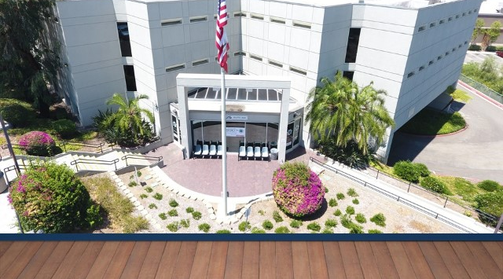
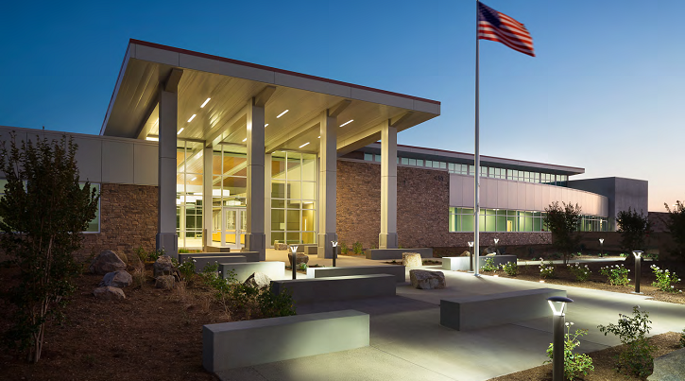
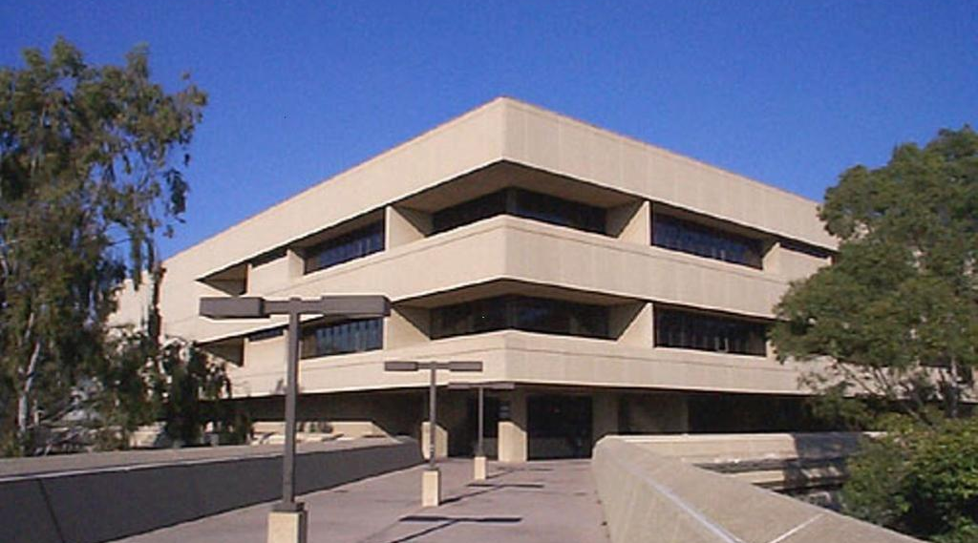
Introductions
Name
DIA or DPT
Facility
Shift
How long have you been with DPD
Why you became a trainer

Slide 3
What we will be covering
Characteristics of a trainer
Teaching strategies
Different ways people learn
Interacting with other generations
Progress, Supplemental, Development Reports
Tracking hours

Slide 4
What we will be covering CONTINUED..
Non-Retention
Staying organized
Scenarios
Getting support and Communication
Staying motivated and Managing burnout
Game Time!

Slide 5
Congratulations you are a trainer!
What is it like to be a trainer
The Good
The Bad
Meet new people
Help people
Promote/Resume
Rewarding!
Meet new people
Attitude
Frustrations
What do you like about being a trainer?

Slide 6
Remember Your first day?
Help your trainee feel welcomed.
Think back to your first day. It’s a new environment, it can be daunting. Let’s help ease some of their worries. Let them tag along for a few days till they learn their bearings.
Provide a tour, show them the common areas (restrooms, breakrooms, ODR, where to buy snacks, DPS Office, Watch Commander’s Office, Briefing room)

Slide 7
Visualize
We want to encourage you to always put your best foot forward when it comes to training.
Remember a year from now, they will no longer be your trainee but your partner on the line. We want to ensure our best training efforts go into helping this individual succeed.

Slide 8
Characteristics of a trainer
Take a few minutes and write down what qualities are desired and expected in a trainer

Slide 9
Characteristics of a Trainer
Trainer
Encouraging
Communicates clearly
Leads by a good example
Supportive
Patient
Respectful
Positive about others
Helpful
Knowledgeable

Slide 10
Teaching strategies
State the objective
Present new material in small steps
Check for understanding
Guided practice
Provide feedback

Slide 11
Different ways people learn
Visual
Auditory
Reading/writing
Kinesthetic (actually performing the task)
“Any training/learning strategy that works is the right one”

Slide 12
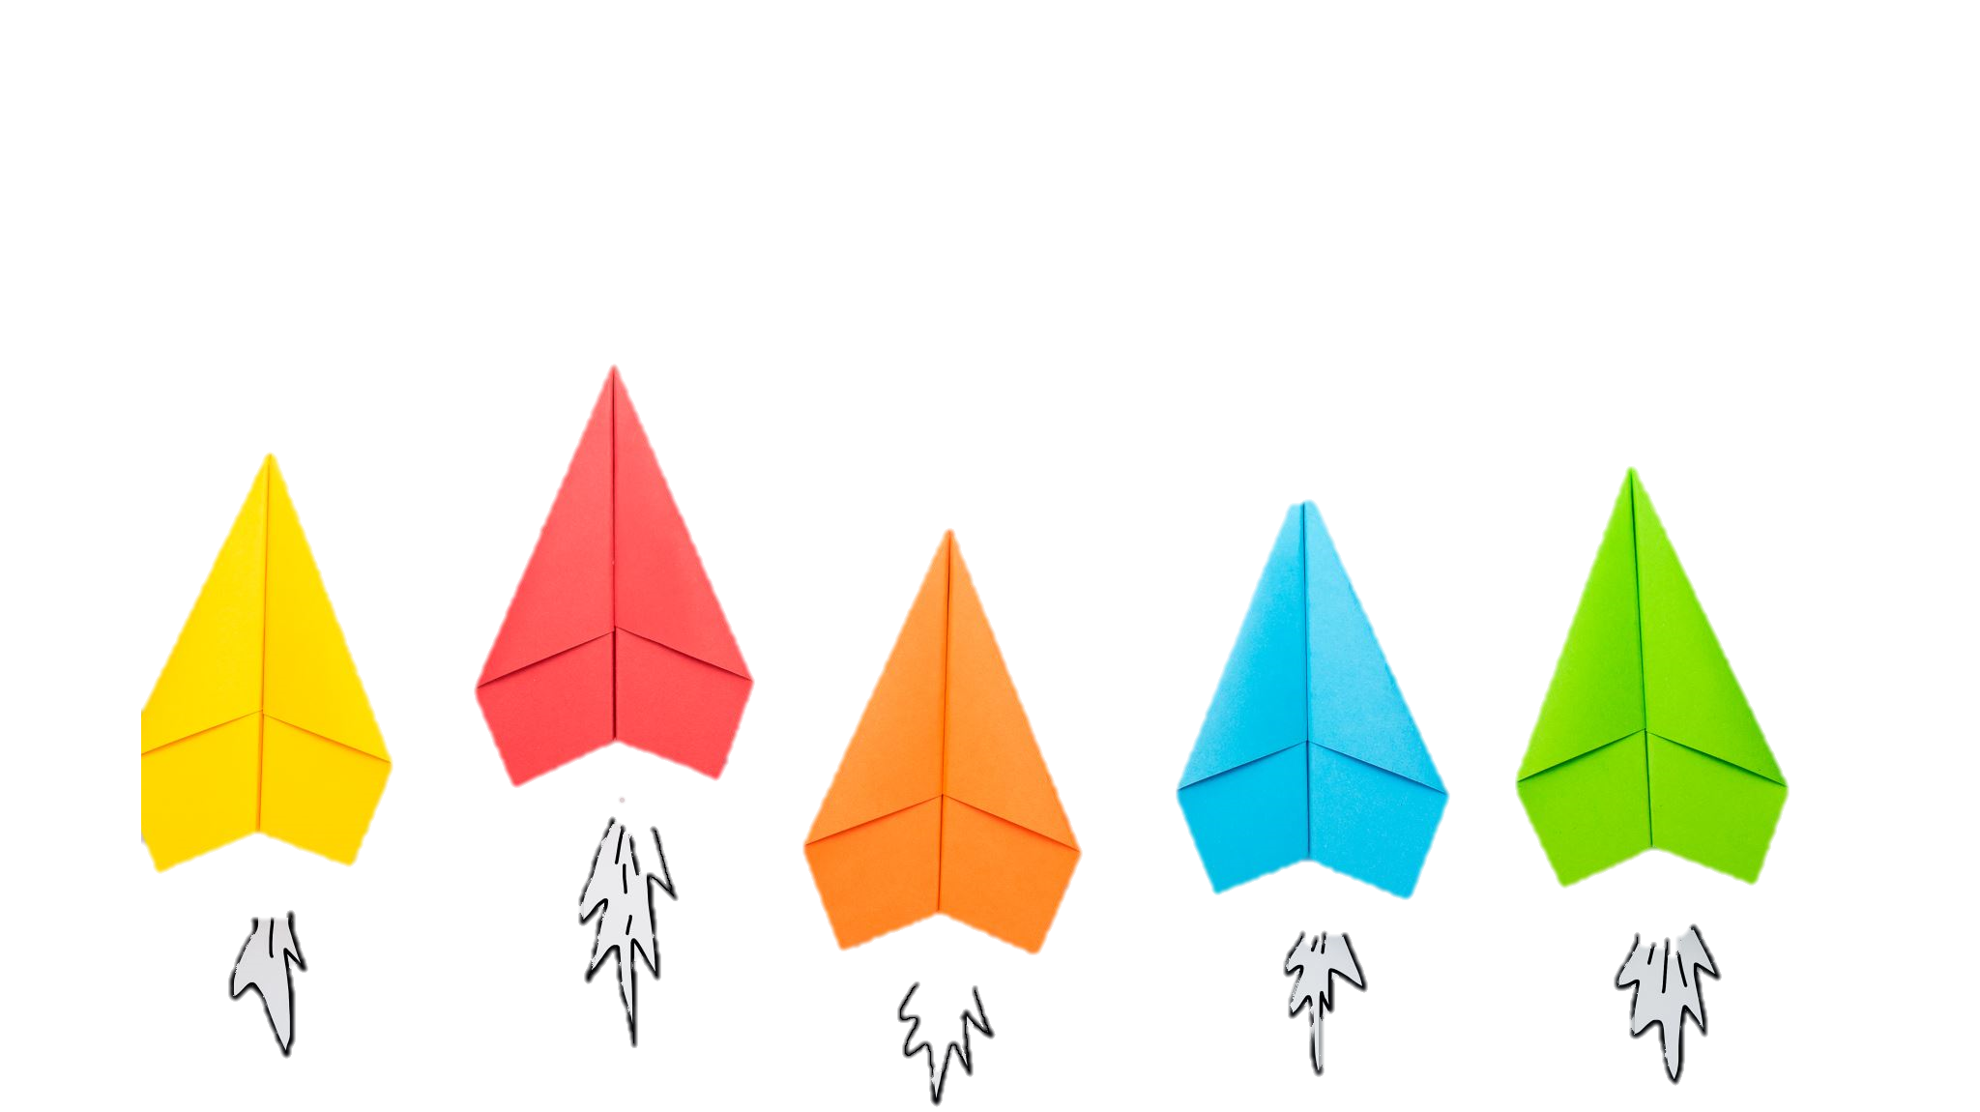
Different ways people learn - Activity
3 Sheets of paper
Round 1 – Auditory
Round 2 – Visual
Round 3 - Kinesthetic

Slide 13
Interacting with other generations
Differences between people of all ages
Communication differences
LMS Training on Generations in the workplace
Generation Island: An Introduction
Generation Island: Generation X
Generation Island: The Baby Boomers
Generation Island: The Millennials

Slide 14
Staying organized
Communicate
with other trainers
Take notes
Which trainee has completed what task
U drive
Create folders

Slide 15
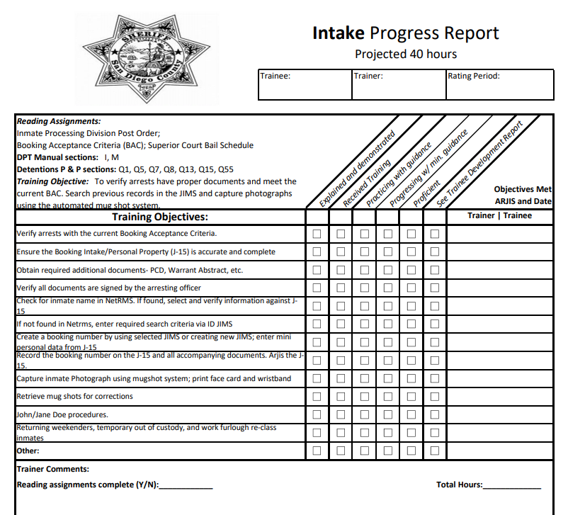
Progress Reports
Please complete them in timely manner
Due every two weeks
Check mark any of the Training Objectives that were processed throughout the rating period.
Explained and demonstrated
Received training
Practicing with guidance
Progressing w/min. guidance
Proficient
See Trainee Development Report -
Trainer Comments- area for you to write any comments
Reading Assignment complete
Total Hours
Praise is encouraged, it doesn’t always have to be negative.

Slide 16
supplemental REPORT
Can be used when additional tasks are presented that are not listed on the Progress Report

Slide 17
Trainee development report
When a trainee requires additional development on a certain topic a Trainee Development Report will be utilized
This form will be completed on a weekly basis in ADDITION to the progress report.
This will be a collaboration between the trainee, trainer, shift DPS, training DPS and the SOS.
Include Print screens

Slide 18
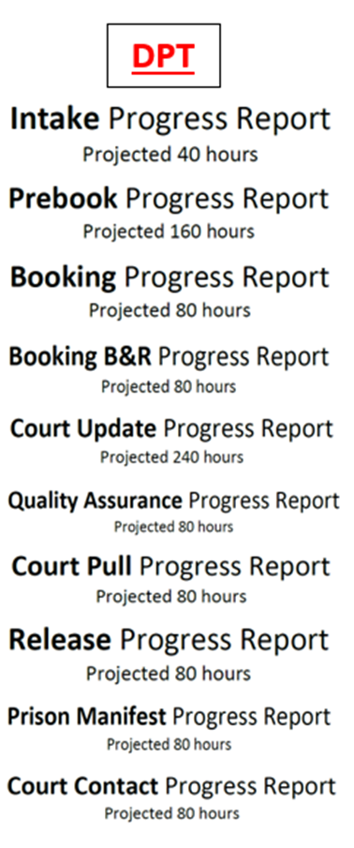
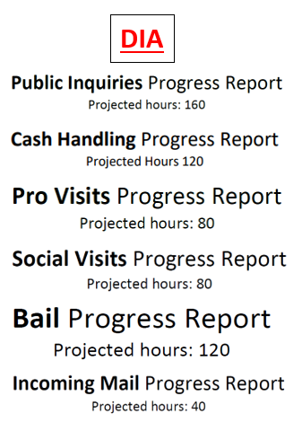
tracking hours
Hours are set as a guideline. Some may require more hours while others will comprehend and be ready to move on sooner.
Make sure to track hours on your progress reports (outlook calendar, copy of schedule, excel spreadsheet)

Slide 19
Final column on progress report
This Replaces the task management form
“In Progress” will be indicated, while training is on going
When a trainee has demonstrated understanding of a training objective the trainer and trainee will date and ARJIS on the line.

Slide 20
completing Progress Reports - Activity
Each Trainer will be given trainee scenarios
Use the scenarios to fill out a Development report

Slide 21
Non-Retention
Speak up, inform your supervisor if you see a trainee is struggling
Complete Progress Reports in a timely manner
Document any reoccurring errors
Another trainer may be assigned to show we’ve tried with multiple trainers.

Slide 22
Confidentiality
responsibility
consequences
Always be mindful of what/where you are saying:
“In Spirit of making trainee better” not “Gossip”
DPS
Peers
Sworn staff
Trainee
Access to JIMS
SDLaw
Custody Records
Emotional well being of others
Written up
I.A. investigation
Lose your job
Criminal case against you

Slide 23
scenarios
You are training 2 trainees at the same time and must cover your own workload
Your trainee keeps making the same mistake over and over
Your trainee does not stay on task, keeps surfing the internet/on their phone instead of handling their workload
Your trainee is continually argumentative toward you and is unwilling to listen to you

Slide 24
Scenarios - Continued
Your trainee has not been trained on certain tasks, however they are attempting to complete them anyway
Your trainee is wearing clothing that does not meet the dress code, your trainee states that it doesn’t bother anyone so it fine and not a big deal
Your trainee keeps talking back to you in a rude manner

Slide 25
Getting support
Having the right tools to get the job done
Training can become overwhelming, it's okay to ask for help
Don’t take it personal – not all trainees and trainers mesh well
Chain of command
Encourage talking to other Trainers and Per Diems
DPS
Training DPS –
Utilizing Training Room – communicate and coordinate with DPS, Training DPS and SOS.

Slide 26
Communication is key
Always keep your DPS informed
Discuss any concerns
Training timeframes
If you have fallen behind on Progress Reports/Trainee Development Report
If you need a break
Access to a trainee’s training file – peruse the previous trainers progress reports to see where the trainee is at in training.
Trainees
Expectations
Timeframes
Where to find our Resources
Explain to them why we do certain things (backstory may result in better memory retention i.e. booking numbers start with the first 2 numbers of the year we are in)

Slide 27
Working effectively with Per Diem Trainers
Mentoring is highly encouraged
Support and incorporate one another when it comes to training. We are an extension of each other, we all want the trainee to do well.
Inform them what a trainee has and has not trained on
Let them know if you want them to go over any new material that may come in
At the end of the day have the per diem trainer send an email which lists some of the material that was covered
Don’t put anyone down, we all have different training methods, don’t state “well that trainer is wrong”. We never want to damage the credibility of anyone.

Slide 28
Staying motivated
Positive attitude – Both you and trainee
Take a break if you need to (don’t get burnt out)
Remember your Resources/Support
Positive encouragement/giving them timetables

Slide 29
managing burnout
Find new ways to engage
Minimize responsibilities (communicate with DPS)
Take time off
Get enough Rest
“Treat your self!”

Slide 30
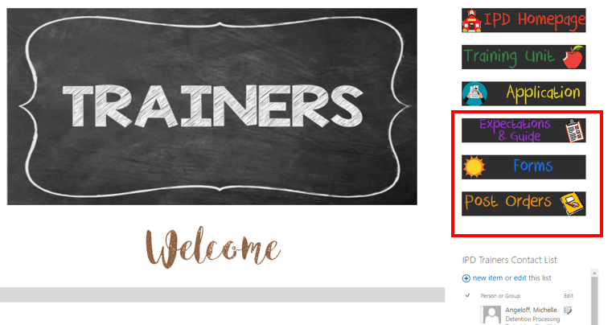
Getting support/Communication - Trainers Page
Have you thought about being a full-time trainer?

