Slide 1
NEW Employee Orientation

Slide 2
IPD TRAINING UNIT

Slide 3
WELCOME TO IPD!
Your name
What facility will you be working at
What position
How long have you been with the county

Slide 4
ICE BREAKER

Slide 5
CHAIN OF COMMAND
SOS
DPS
Trainer
YOU
Assistant Manager
Manager

Slide 6
MISSION AND VALUES
IPD Mission Statement
We provide the highest quality detention processing and customer service to the community.
Core Values
Honesty, Integrity, Loyalty, Trust, Respect, Fairness, and Diversity.

Slide 7
DRESS CODE
Casual slacks
Denim pants (no blue jeans)
Long or short sleeved shirts
Sweaters
Polo shirts
Sweatshirts
Dresses
Blouses
Dress shoes
Athletic shoes
Hiking boots
All clothing must be clean, without holes or fraying and not overly distressed

Slide 8
CASUAL FRIDAY/WEEKENDS/C-SHIFT
Casual slacks
Capri pants (shorter than mid-calf unacceptable
Sports shirts
Sweatshirts
T-shirts
Skirts
Dresses
Blouses
Sweaters
All clothing must be clean, without holes or fraying and not overly distressed

Slide 9
FACILITIES
San Diego Central Jail
1173 Front Street
Supervisor: (619) 615-2818
Information: (619) 615-2737
Booking: (619) 615-2662

Slide 10
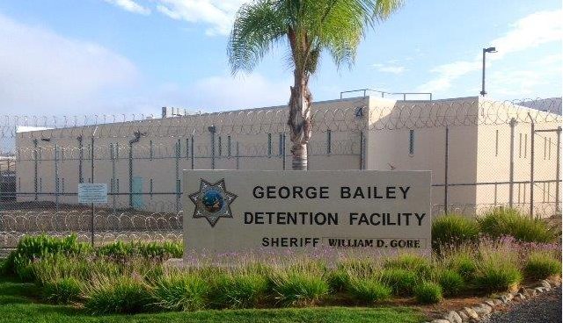
FACILITIES
George Bailey Detention Facility
446 Alta Road Suite 5300
Supervisor: (619) 661-2655
Information: (619) 661-2655
Booking: (619) 661-2650

Slide 11
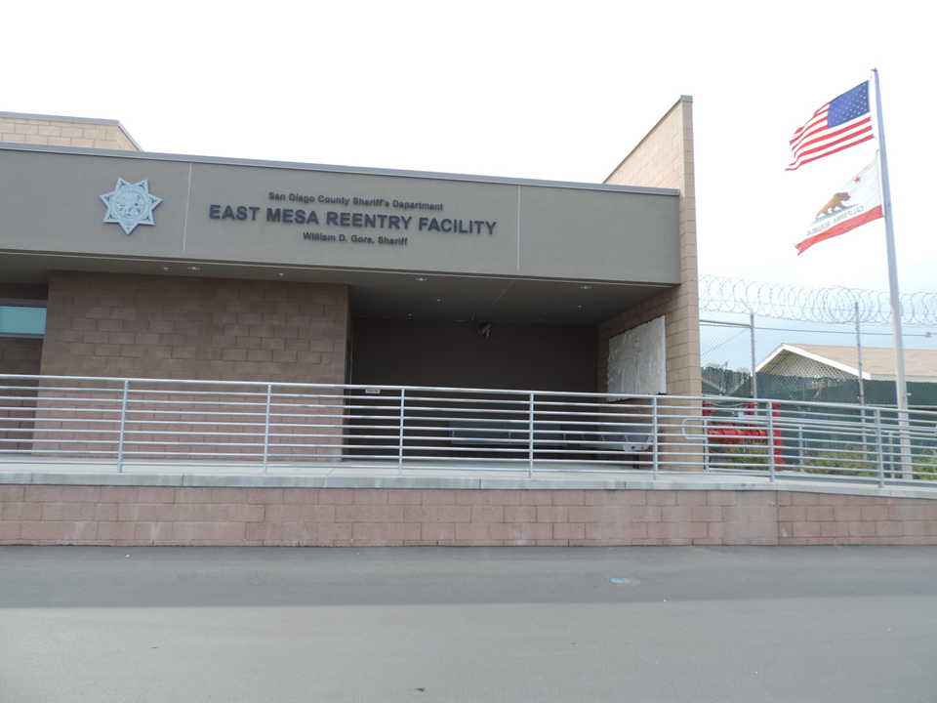
FACILITIES
East Mesa Reentry Facility
446 Alta Road Suite 5200
Supervisor: (619) 661-2655
Information: (619) 661-2940
Booking: (619) 661-2953

Slide 12
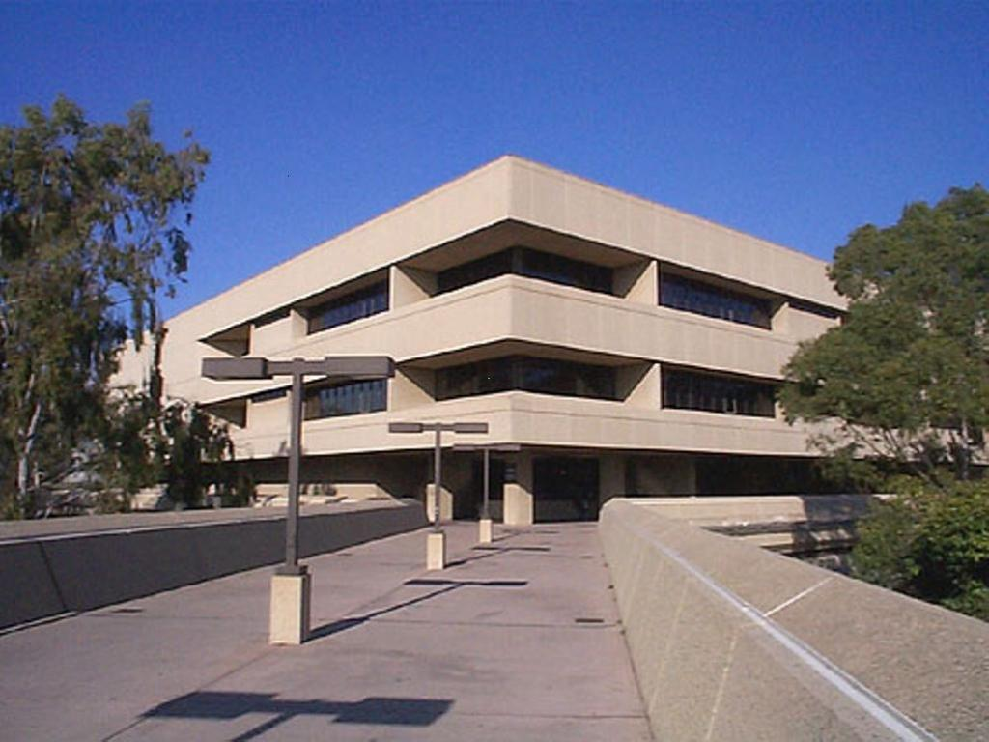
FACILITIES
South Bay Detention Facility
500 Third Avenue
Supervisor: (619) 691-4429
Information: (619) 691-4817
Booking: (619) 691-4626

Slide 13
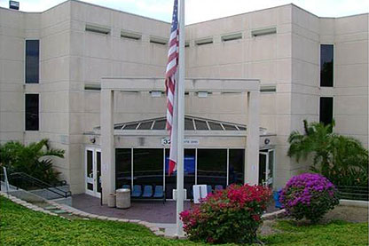
FACILITIES
Vista Detention Facility
325 S. Melrose Drive #200
Supervisor: (760) 940-4481
Information: (760) 940-4997
Booking: (760) 940-4486

Slide 14
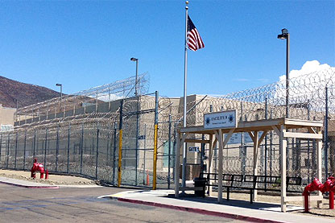
FACILITIES
Facility 8
446 Alta Road Suite 5300
Supervisor: (619) 661-2655
Information: (619) 661-2702
Booking: (619) 661-2831

Slide 15
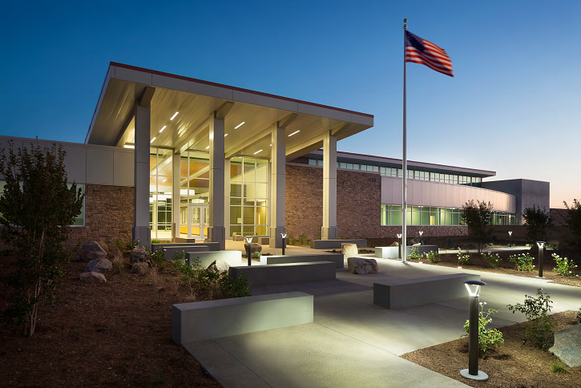
FACILITIES
Las Colinas Detention & Reentry Facility
451 Riverview Parkway
Supervisor: (619) 258-3005
Information: (619) 258-3350
Booking: (619) 258-3000

Slide 16
HOW TO LOG-IN
EMAIL
JIMS
SDLAW
KRONOS

Slide 17
TRAINEE EXPECTATIONS
What are your expectations?

Slide 18
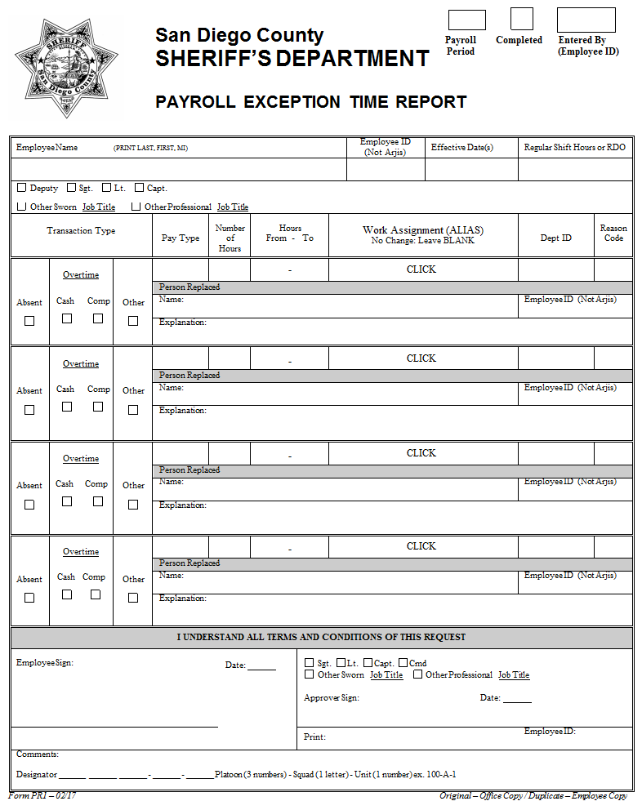
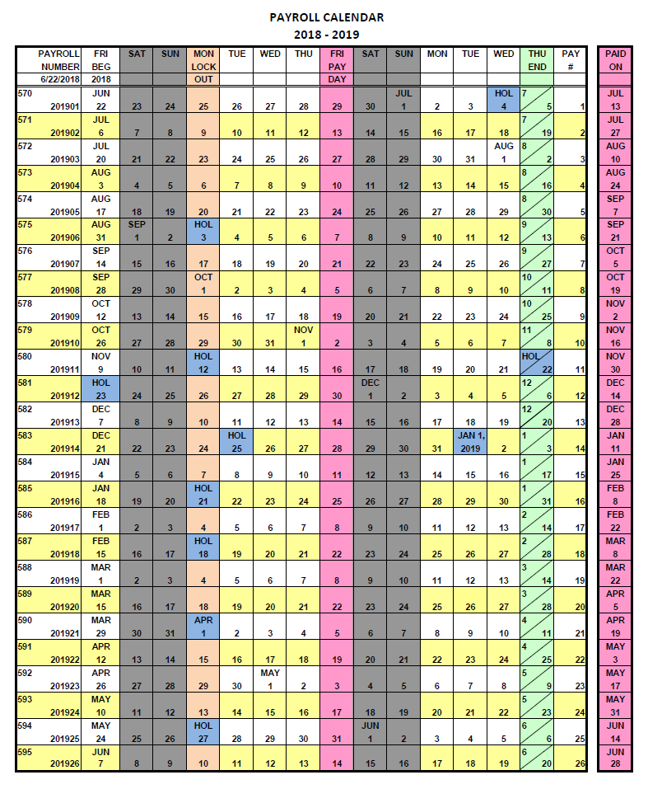
REQUESTING TIME OFF

Slide 19
COMMON PAY CODES
VAC – Vacation
CTO – County Time Off
FHO – Floating Holiday
SLP – Sick Leave, Personal
SLO – Sick Leave, Other
FML – Family Medical Leave

Slide 20
OUTLOOK AND SKYPE
Property of San Diego Sheriff's
No expectation of privacy

Slide 21
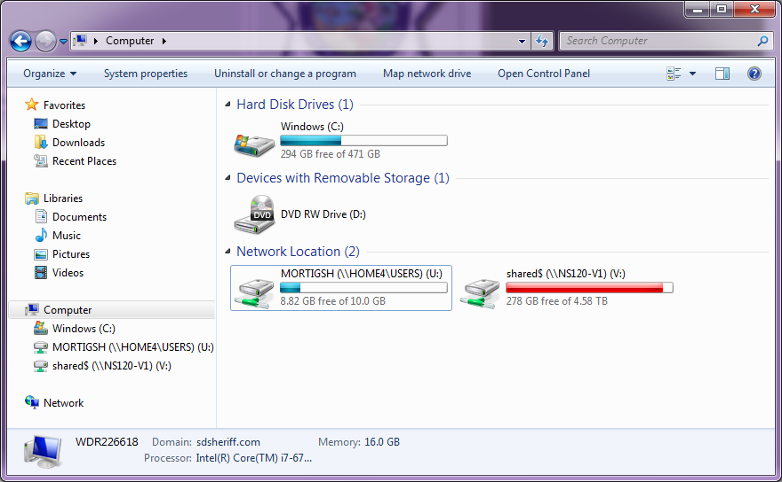
(U:) DRIVE

Slide 22
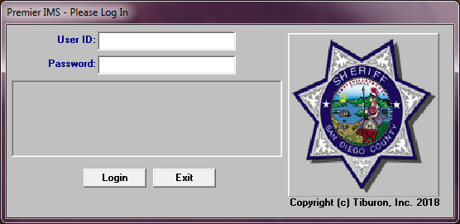
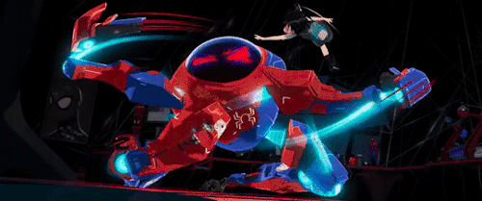
JIMS CAPABILITIES

Slide 23
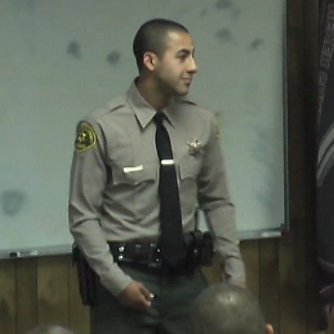
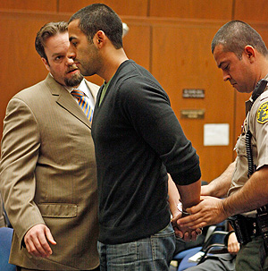
FELIX

Slide 24
CUSTOMER SERVICE

Slide 25
GUEST SPEAKER

