Slide 1
WEB ID SYSTEM
Also called Rapid Identification System
A quick way to identify an inmate’s identity via fingerprints prior to release from custody

Slide 2
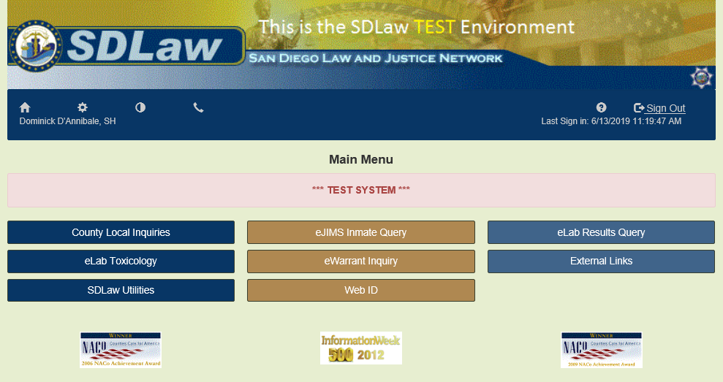
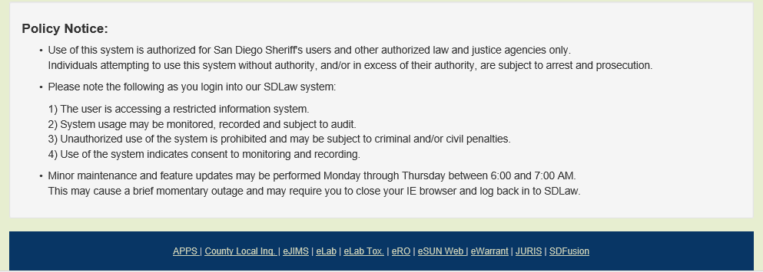
The Rapid ID System is a small device attached to the final release workstations via USB connection. To access the Web I.D application log into the SDLaw Main Menu and click the Web I.D. button.

Slide 3
The Web ID system has a log in list for all Law Enforcement agencies, for IPD users it will be SDSheriff. Each IPD users will log into the Web ID application using the Username assigned by SDLaw and their unique password.

Slide 4
To use the system, start by clicking on left index box (on the grey area, not on the text)

Slide 5
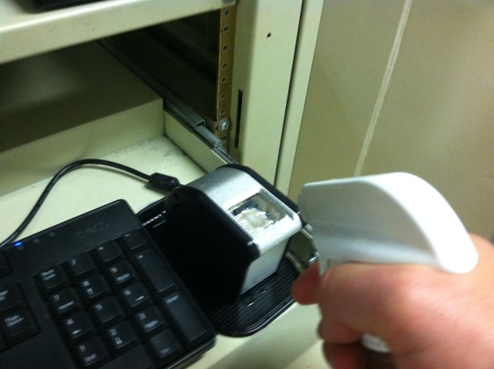
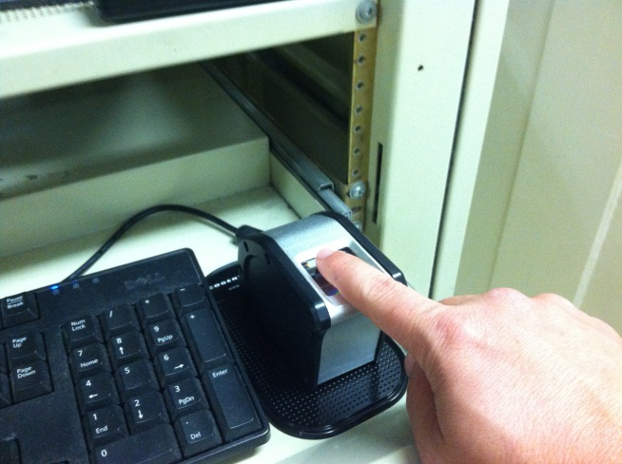
A dialog box will open prompting you to scan the fingerprint. Moisten the left index finger and place it on the scanner. Do not roll the finger.

Slide 6
Hold the left finger on scanner until the Finger Print Scanner Dialog box disappears. Repeat steps for the right finger.
Print will show here
This box will disappear once the print is accepted.

Slide 7
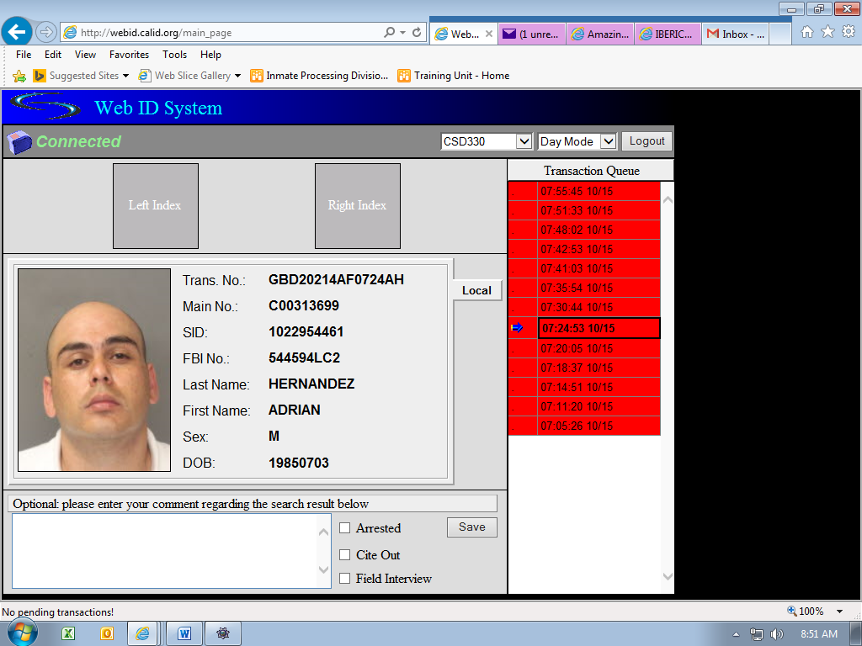
Once both prints are captured, wait until the date/time information in the Transaction Queue turns “red” for a positive match or “green” for no match. On average, the search process should take approximately 20 seconds.

Slide 8
The system will supply pertinent demographic information for identification, including the a mug-shot photo, AFIS (Main No.) and FBI number. Confirm the identity of the inmate by comparing with the JIMS information.
The “Rapid ID System” searches the San Diego AFIS (automated fingerprint information system) database only.
If you do not get a positive match, retry the process again.
TIP: If an inmate does not have a right index finger, another finger may be used; however, there MUST be a left index finger to use the system.

