Slide 1
Phase III
Day 4

Slide 2
Commitment Info
Waives 4019 Credits: Past , Present & Future
Consecutive –
If consecutive to each other - longest commitment goes last
Flash Incarceration – 3453(Q)
Hourly Commit – Training Bulletin
Ex: 96 hrs / 2 tcc – NO 4019 credits
96 hrs / 0 tcc – entitled to 4019 credits

Slide 3
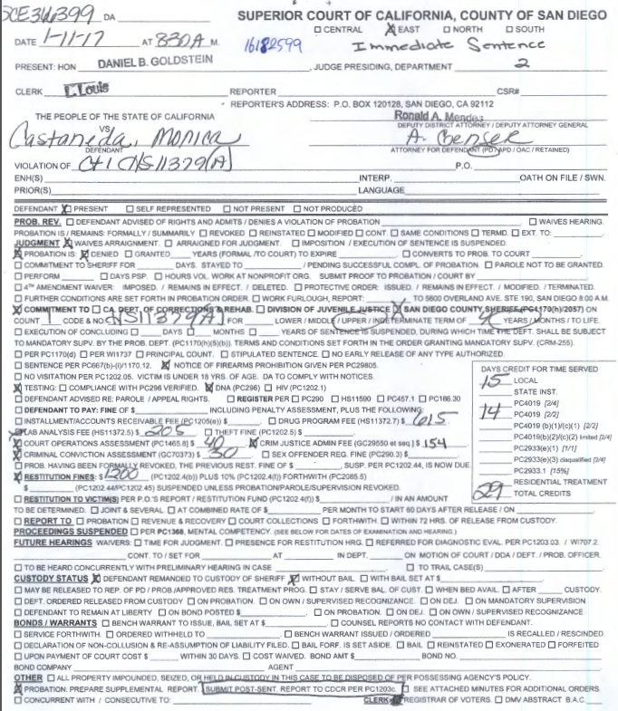
Example #1:

Slide 4
JIMS
Local Prison Commit 4 yrs/29 TCC 2/2
Awt Pkg (today's date)
1170
LPAP

Slide 5
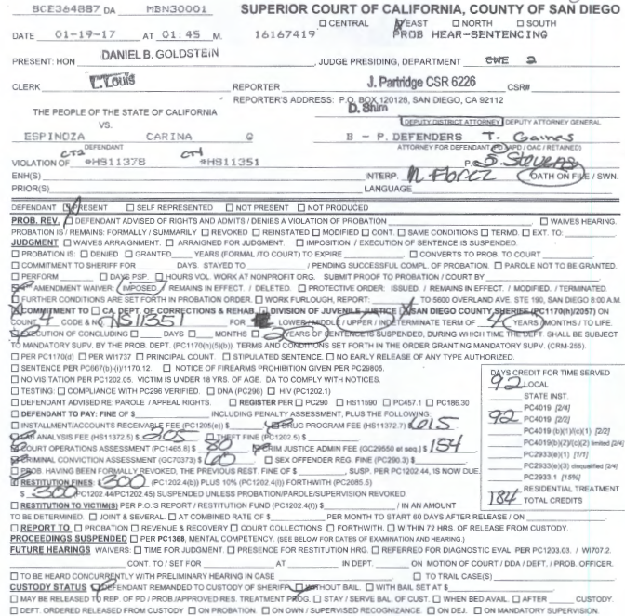
Example #2:

Slide 6
JIMS
Local Prison Commit 4 yrs/2 yrs susp/184 tcc 2/2
Awt Pkg (Today's date)
ICS
ICS
LPAP

Slide 7
Exercises
Sutil, Landon
Guthrie, Vincent
Johnson,Richard-b1c1
Ellis, Scott
Holt, Kathleen
Bedolla, Male
Jensen, Mark
Cohen, Richard
Mendez, Raul
DOB: 9/02/1970

Slide 8
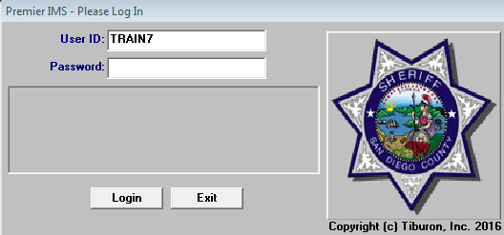
Exercises
**JIMS Login-User: Train & Terminal Number Ex: Train7

Slide 9
Exercises
SUTIL, LANDON
RICO, DAVID
JOHNSON, RICHARD
ELLIS, SCOTT
PARKER, JEFF
HOLT, KATHLEEN
SCIMECA, RONALD

Slide 10
Exercises
SUTIL, LANDON
ELLIS, SCOTT
HOLT, KATHLEEN
SCIMECA, RONALD

Slide 11
Exercises
SUTIL, LANDON
HOLT, KATHLEEN

