Slide 1
Phase 2
Day 3

Slide 2
Order TO produce
Issued by the court
A document ordering a person to appear in court on a judicial matter
If the OTP document has bail amount then should be processed as an additional arrest
Arrest type: Booked Remand (BRMD)

Slide 3
Order TO produce
If an OTP is received on a case that the incarcerated individual is not booked on, the OTP date is entered as an Additional Court date
NOTE: When entering the OTP date, the case number assigned must be entered to distinguish which case the incarcerated person is scheduled for

Slide 4
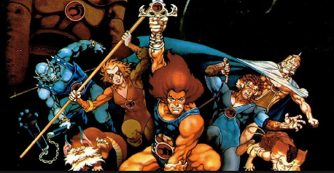
Juvenile court
The court may issue an order for a defendant to attend a Juvenile Court hearing
The court date must be entered using an additional court date line.
If there is a bail amount shown on the document, then book as an additional arrest

Slide 5
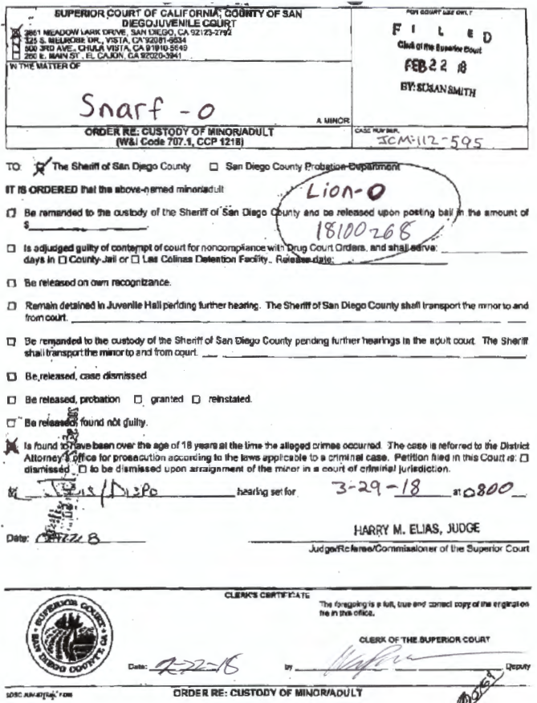

Slide 6
Pro Per
"In Propria Persona" "Lopez Waiver"
Represent themselves
Must be granted by the court
Given certain privileges
To assist the incarcerated individual in preparing their defense
Status can be revoked by the Watch Commander

Slide 7
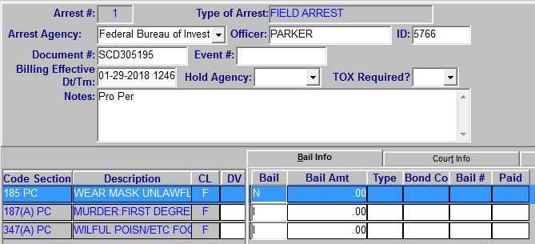
Pro Per
Distribute copies to the Incarcerated person, Classification, Pro Per Deputy and/or Counseling
Notate the distribution of the copies at the bottom of the document. Ex. CC: Class/Pro per dep/counseling
Notate the Pro Per status in Maintenance notes

Slide 8
Exercises
Applestein
Covarrubias
Demara
Diaz
Foster
Matheson
Templeton
Valencia

Slide 9
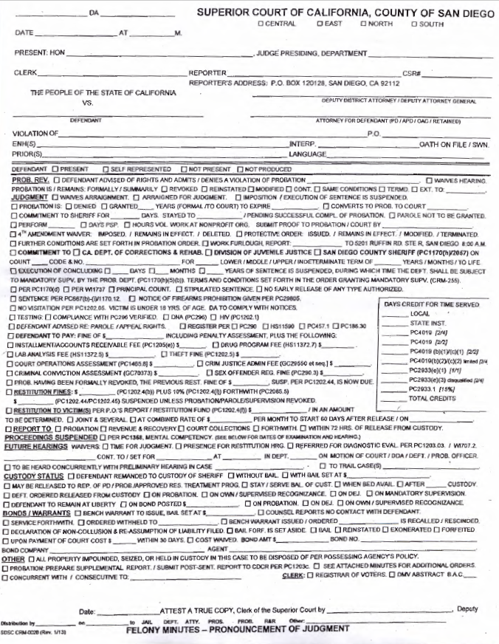
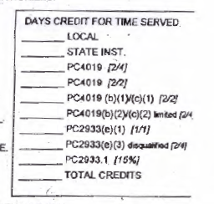
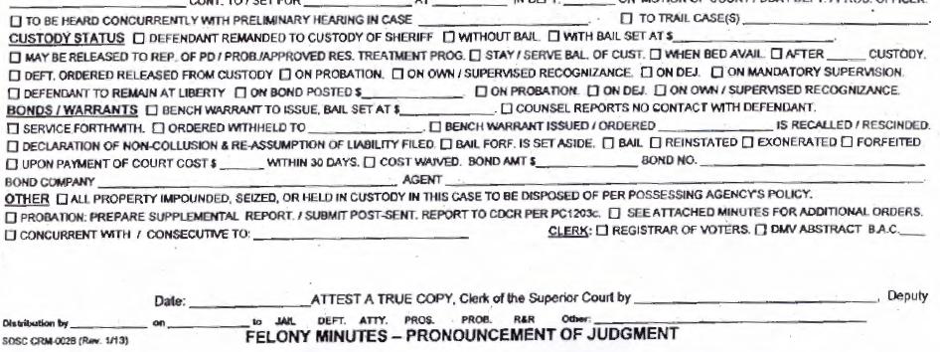

Slide 10
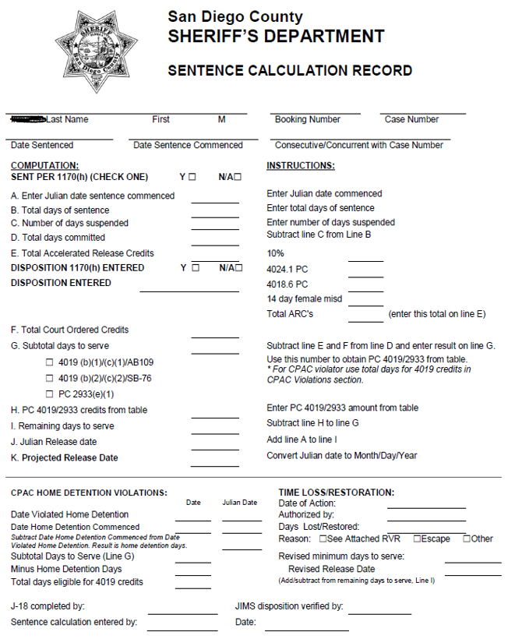
J-18 Sentence Calculation Record

Slide 11
exercises
Palmer
Salazar
Stubblefield

Slide 12
exercises
Leeon
Thomas
Vasquez

