Slide 1
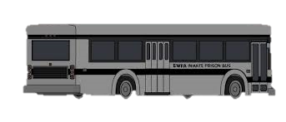
Detentions Processing Division
Phase II Day One
Notes:
NOTE:
To change the image on this slide, select the picture and delete it. Then click the Pictures icon in the placeholder to insert your own image.

Slide 2
Ground Rules
Your name
What Facility and shift
Where you are in your training

Slide 3
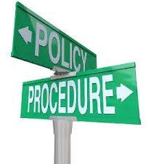
Policy and Procedure M.5 – Taking appropriate action
If you witness a medical emergency…
Notify sworn/medical staff immediately”

Slide 4
Review Phase I: Resources
San Diego Sheriffs Web Page
DPD Web Page
Who's in Jail website
DPT Manual
DIA Manual
Stock Clerk Manual
Pre-Book Manual
Sentence Calculation Manual
Bookings Acceptance Criteria
SD Law
LMS
Bail Schedule
California Code
Department Policy & Procedure
Detentions Policy & Procedure
Training Bulletins

Slide 5
Review Phase I: Resources
What is the order in which bookings are processed?
Where can you find this information listed?
Local Cases (Field arrests, SD County warrants,
State Parole – PC 3056
Out of County
State (H-STPs, 3151 WI, CYA/DJJ
Federal
Fugitive
ICE
(DPT Manual => UPDATE => PG. 14)

Slide 6
Judicial Process
Suspect arrested based on probable cause
Report submitted to District Attorney – DA has 48 hours to submit case
District Attorney drops case
District Attorney files on case
Incarcerated person seen at court for arraignment
Incarcerated person released on this case
Note: Misdemeanor cases = City Attorney
Felony cases = District Attorney

Slide 7
Judicial Process
Attempt to reach a settlement
Disposition reached – incarcerated person scheduled for sentencing
Disposition not reached – Schedule for preliminary hearing
Judge finds evidence to be insufficient
Motion to Suppress Evidence/Dismissal for Lack of Evidence
Incarcerated person released on this case
Settlement Conference

Slide 8
Judicial Process
Incarcerated person has 60 days to appeal sentence
Change of plea – incarcerated person sentenced
Jury Trial
Found not guilty
Incarcerated person released on this case
Found guilty
Incarcerated person sentenced
Incarcerated person has 60 days to appeal sentence

Slide 9
Court Updates
Why is court updating so important?
Consequences to a bad update:
Appearance on the wrong court, day or time
Bail posted for the wrong amount or incarcerated person
Erroneous release
Operational Aspect from the sworn side:
Security Issues, Classification, Sheriff's Trans, large liability can result, etc.
UPDATES GONE WRONG VIDEO

Slide 10
Court Update
Take a few minutes to write down as many of the following:
Information you can find on a court paper
Example: Name, charges, etc..

Slide 11
Court Update
Court updates must be done through the Court Scheduling Navigator
Update charges, bail, Case number, ROC, future court date, and Disposition
Enhancements: Will NOT be entered
Infractions: Can be added
More charges: We are not required to list the additional charges
Wobblers: A charge can be a misdemeanor or felony
Examples:
Walter White
Jesse Pinkman

Slide 12
Court Updates
The basics of a court paper
Pre-dispo/judgement minutes
Court jurisdictions
Name
Case #
JURIS #
DOB
Booking #
Court/Future/Vacated
Court/Hearing/Destination
Specific court instructions
Custody Status

Slide 13
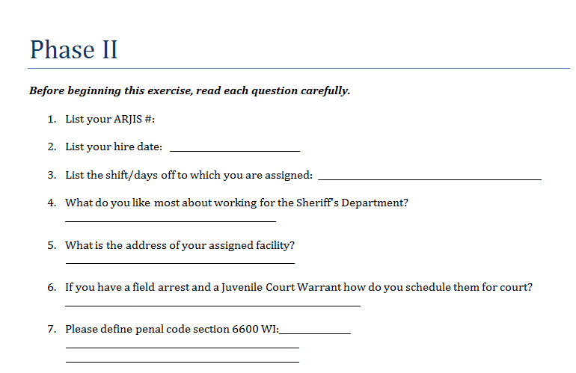
Complete the worksheet

Slide 14
Reason on Calendar
Helps the court determine why an inmate was scheduled for court
ARR
FP
PHS
SAR
COTP
OTP
BR
JT
ID
ZE

Slide 15
Dispositions/Custody Status/Release Types
DNI
DISM
825
ROR
SPTS
CTS
SNT
B&R
B(1)
B(2)
PROB
NINA
ERR
oth

Slide 16
Additional Arrest
B-Bookings
Remands
Multiple arrests
Rebooking Booked & Hold arrest types
Ex: Out of County, Federal Warrants, ICE Holds, etc.
Contact outer facilities to re-book holds, otherwise can result in an over detention
The Arresting Agency will be SDSO and the Billing Agency will be SDSO

Slide 17
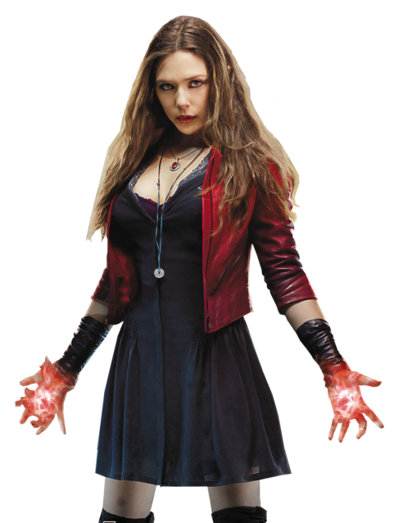
Bail review
The court may order a defendant to appear for a bail review hearing as well as a further proceedings date
Must be entered on last active charge line in JIMS
Note: If the incarcerated person post bail, the Bail Review date will be removed and replaced with the Further Proceedings date

Slide 18
Update Per PC 17(B)(4)
What is it?
An order to change an offense from a Felony to a Misdemeanor
How is this done?
Update the original charge, do not add a new charge

Slide 19
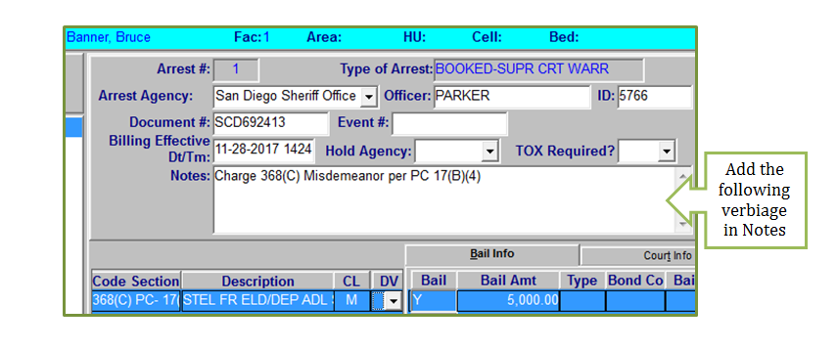
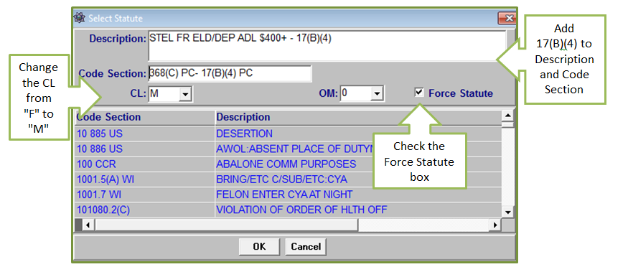
Update Per PC 17(B)(4)

Slide 20
SDLAW- Matching a document number to correct arrest in JIMS
The case number found on the court document will be entered on the DA10 screen
An inquiry on SD Law's DA10 screen will be used

Slide 21
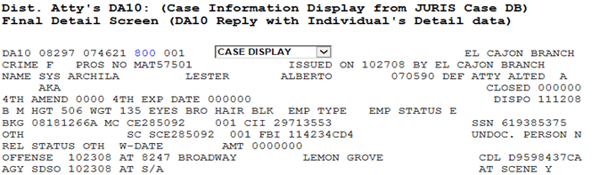
SDLAW- Matching a document number to correct arrest in JIMS
The agency, offense date and location will be matched with what is shown on JIMS
Found under Full Personal Data, the location of arrest can also be matched

Slide 22
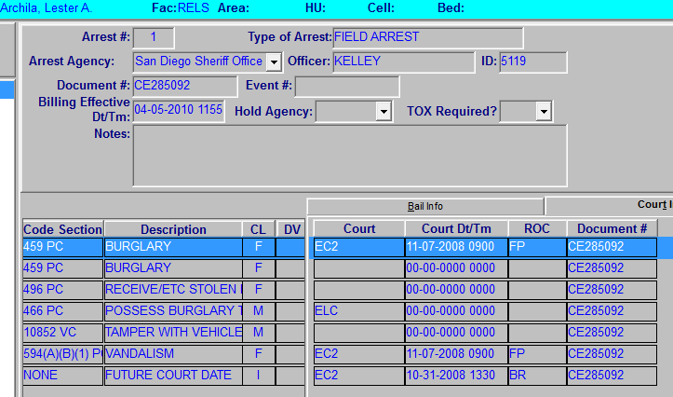
SDLAW- Matching a document number to correct arrest in JIMS
Once matched, add the Document number in JIMS
Add the Document Number on all applicable charges

Slide 23
EXERCISES
exercises
Archila
Leeon
McLucas
Tello
Templeton
Thomas

Slide 24
Scheduling Events
Event Types:
DAPU: District Attorney Pick-up
GPS: GPS device needs to be installed on an incarcerated individual prior to release
JBCT: Jail Based Competency Treatment
LEPU: Law Enforcement Pick-up
PKUP-Schedules an incarcerated individual for pick-up by other agencies, Courtesy Housing or Enroute Incarcerated individual.
RPCO-Releases an incarcerated individual on their own to the streets on a specific date/time per court order
TRAN: Incarcerated individuals being transferred to different facilities

Slide 25
Scheduling Events
Destination
NO BUS: Utilized when representatives or agents contact the facility to make pick-up arrangements for incarcerated individual or when an inmate is being released out of the same facility from which they are housed.
Facility: Utilized when an incarcerated individual is being released out of another facility from where they are housed.
Enter information pertinent to the pick-up in the Comments field
NOTE: Due to officer safety concerns, NEVER enter this information under the notes section of the Maintenance screen in JIMS.

Slide 26
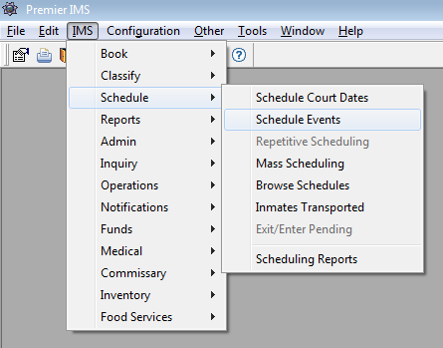
SCHEDULING EVENTS
To access: IMS > Schedule > Schedule Events

Slide 27
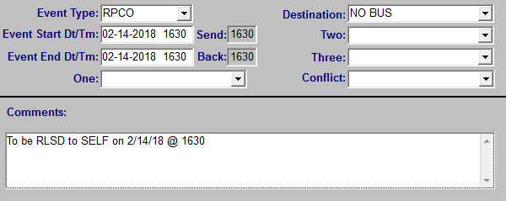
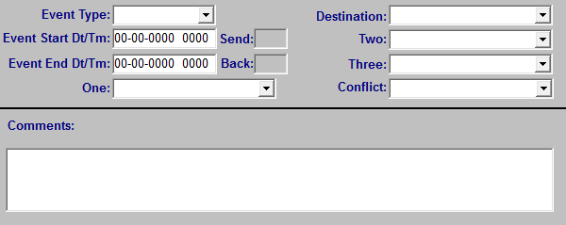
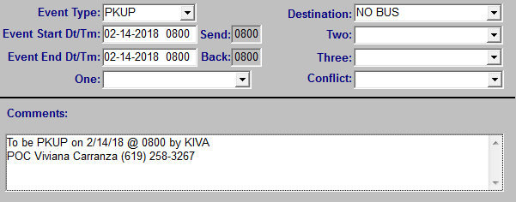
SCHEDULING EVENTS
RPCO – Release Per Court Order or PKUP – Pick UP By Agency
Example # 2 - RPCO
NO BUS – Hold For Pick Up – No Bus
Example # 1 - PKUP
Enter the time and date according to the event
Enter information according to the event

Slide 28
EXERCISES
exercises
Lackey
Lafond
Outlaw
Todd
Tolusas
Whitaker

