Slide 1
Day Five
Detentions Processing Division Training Unit

Slide 2
What is the booking order?
Local cases (field arrests, warrants, 3056 PC)
Out of County
State (CYA/DJJ, WI 3151, Parole violators. Etc.)
Federal
Fugitive
ICE

Slide 3
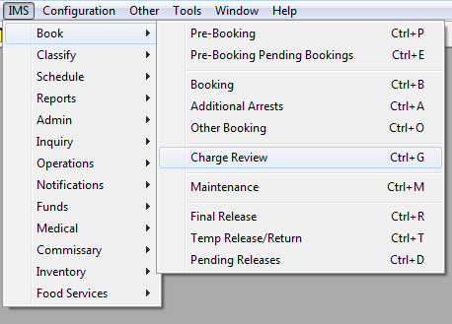
Charge review
To access: IMS > Book > Charge Review

Slide 4
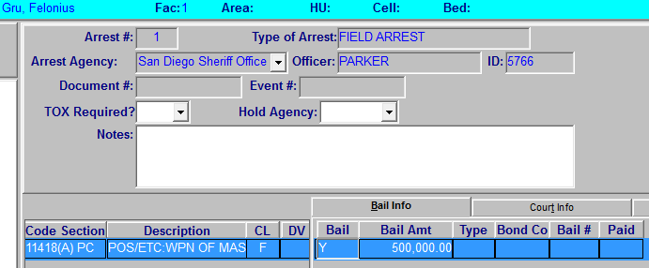
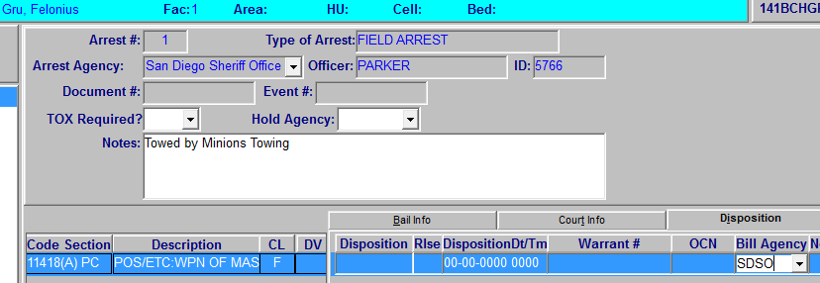
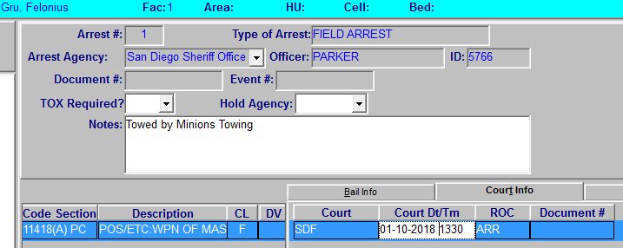
Charge Review

Slide 5
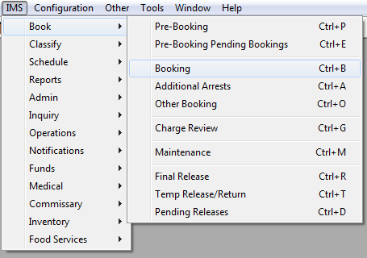
Pending bookings queue
To access: IMS > Book > Booking

Slide 6
Pending Bookings Queue

Slide 7
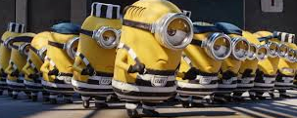
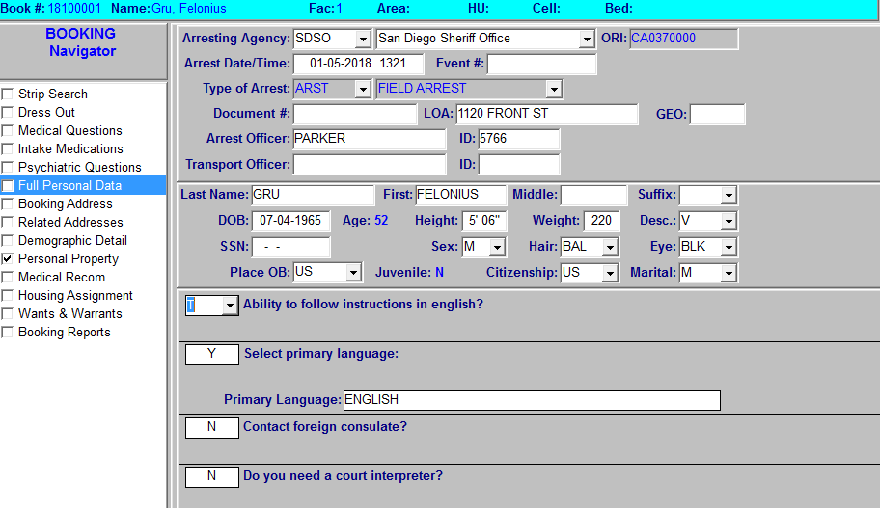
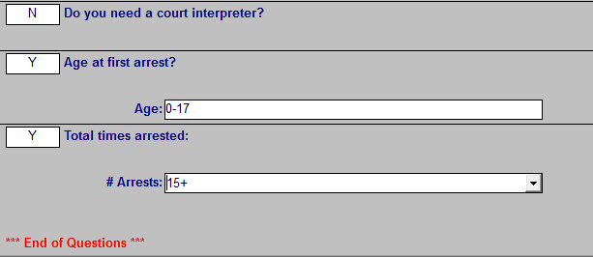
Full Personal Data

Slide 8
Booking Address

Slide 9
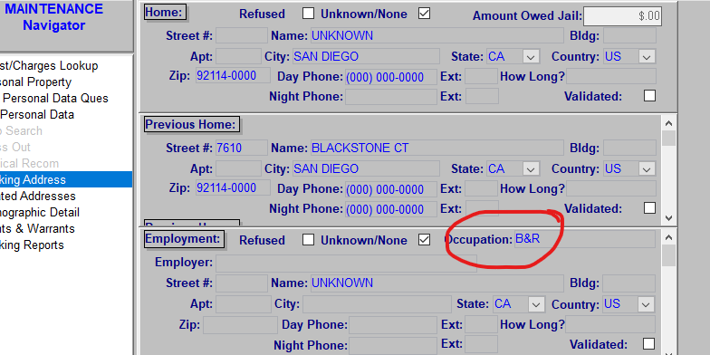
Do not get creative!
If you see someone wrote “B&R” for occupation, please remove it
This becomes part of the inmate's record

Slide 10
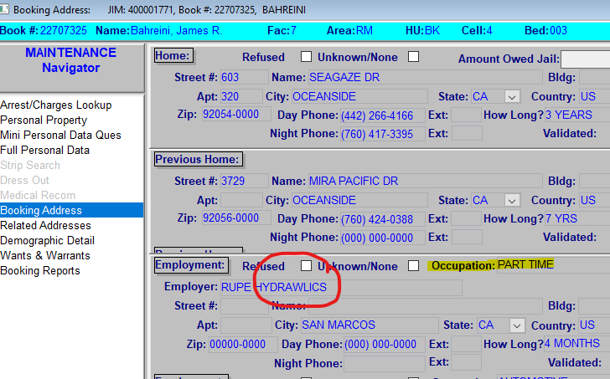
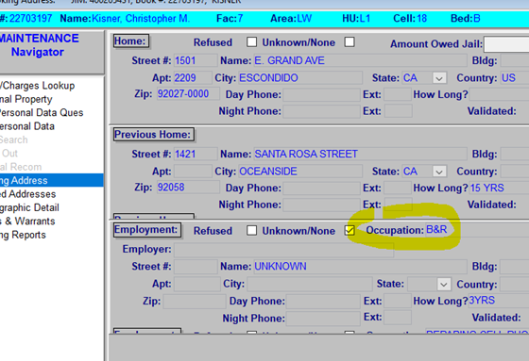
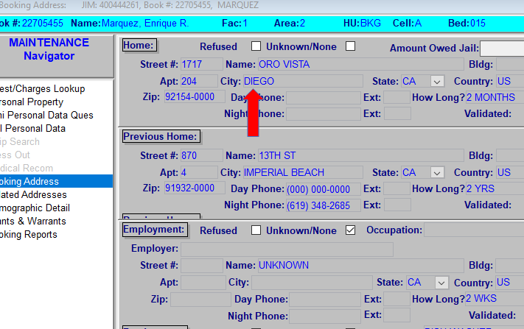
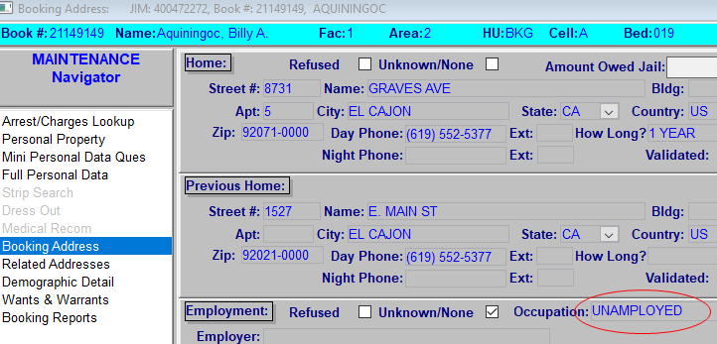
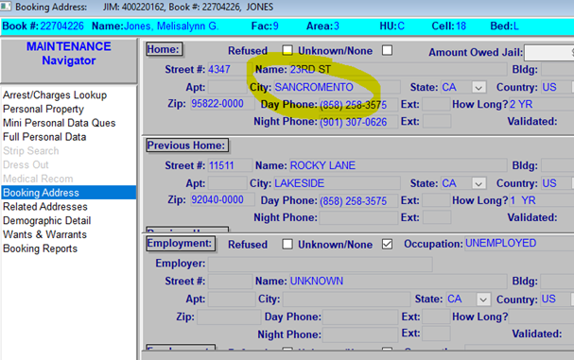
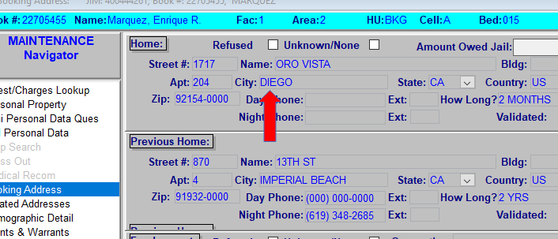
Be mindful of spelling/responses
This becomes part of the inmate's record
Many people will see this!

Slide 11
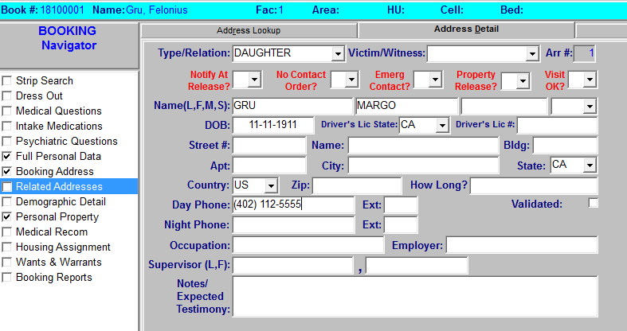
Related Addresses

Slide 12
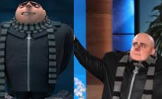
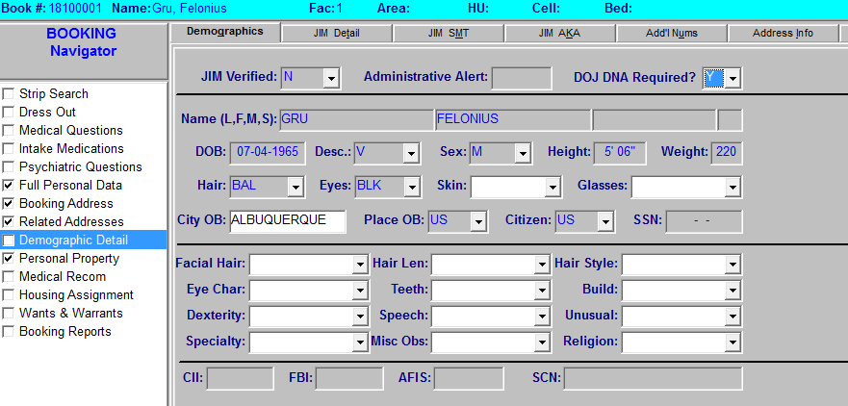
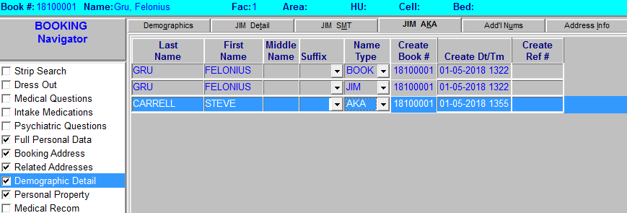
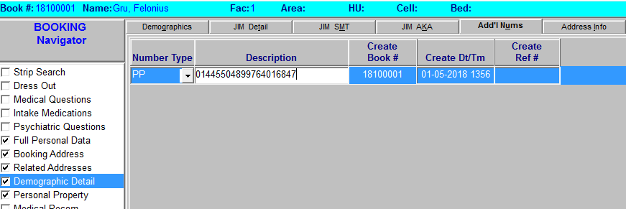
Demographic Detail

Slide 13
Wants & Warrants

Slide 14
Wrong person on warrant
If an incarcerated person claims they are not the person on the warrant, follow the steps below:
Fill-out a Q.80 form
Deliver to your on-duty Supervisor
A JPMU Sergeant or deputy will be notified
A JPMU deputy will provide all documentation to the watch commander who will decide the outcome
Attach a copy of the Q.80 form to the booking jacket

Slide 15
Courtesy housing
Must have prior approval from the watch commander
DPT Manual
How to Pre-Book

Slide 16
Minors
Policy and Procedures Q.9
If an incarcerated person is suspected to be a minor, notify the on duty watch commander
If determined to be a juvenile, the individual will be transferred to Juvenile Hall

Slide 17
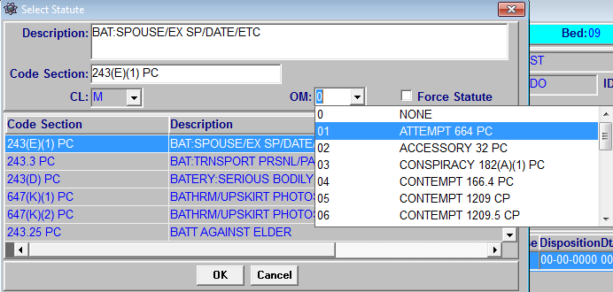
Offense modifier
664 PC Attempt is the only Offense Modifier approved to use by the department

Slide 18
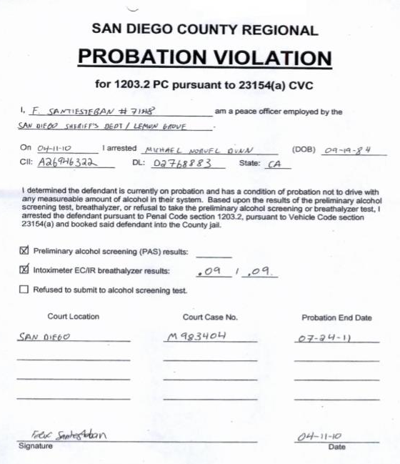
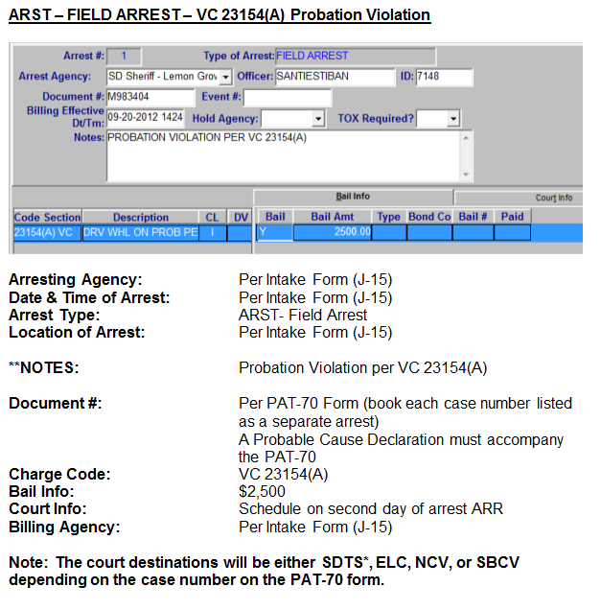
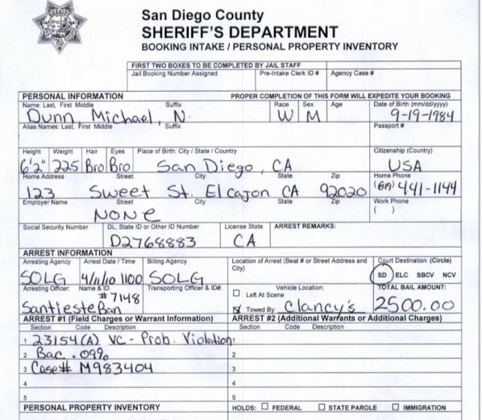
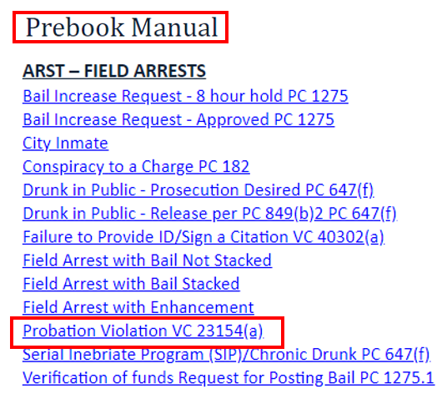
Probation Violation per 23154(a) VC
PAT-70 Form
PCD + PAT-70 Form
PAT-70 Form
One arrest
Field ARST – 23154(a) VC
Schedule court for second day
SDTS*, ELC, NCV, SBCV
Fax to the facility according to the court destination
Ex. El Cajon case – fax to LCDRF
Two arrests
1. Field ARST – DUI
2. Field ARST – 23154(a) VC
Schedule court for second day
SDTS*, ELC, NCV, SBCV
Fax to the facility according to the court destination
Ex. El Cajon case – fax to LCDRF

Slide 19
Exercises
Koppel
Torstrom
Alvarado
Croteau

