Slide 2
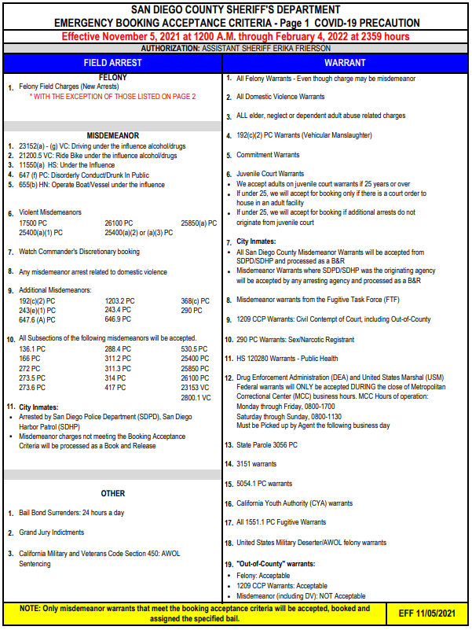
On July 2nd, 2021 the CITY Incarcerated Persons Program was reinstated. In accordance with the current BAC, CITY Incarcerated persons arrests are to be processed as book and releases.

Slide 3
What are CITY Incarcerated Persons?
An agreement signed in 1998 between the City of San Diego and the County of San Diego allowing the City of San Diego to pay for bed space to house CITY misdemeanants brought in by the San Diego Police Department (SDPD) and/or San Diego Harbor Patrol (SDHP)

Slide 4
Who Qualifies as CITY?
Field Arrests brought in by SDPD/SDHP that do not meet the BAC
MISD Warrants, with charges not meeting the BAC, from SDPD/SDHP
MISD warrants originating from SDPD/SDHP
Charges on the second page of the BAC

Slide 5
In a Nutshell
Field Arrests/Warrants
Meets the BAC: Not a CITY Incarcerated person
Does not meet the BAC: CITY Incarcerated person
Book & Release (B&R)
Stand alone charge: Not a CITY Incarcerated person and a B&R
SIP/Chronic/Accompanies a charge not on the BAC by SDPD/SDHP: CITY Incarcerated person
Warrants Other Agencies
Does not meet the BAC, but SDPD/SDHP Originating: CITY Incarcerated person
Does not meet the BAC, and SDPD/SDHP not originating:
PC 17(b)(4)
SDPD/SDHP Reduces a charge from a felony to a misdemeanor and does not meet the BAC: CITY Incarcerated person

Slide 6
Warrant abstracts identify the arresting agency but do not always identify the originating agency. SDLaw (MA10) screen is used to identify the correct originating agency.
Originating Agency

Slide 7
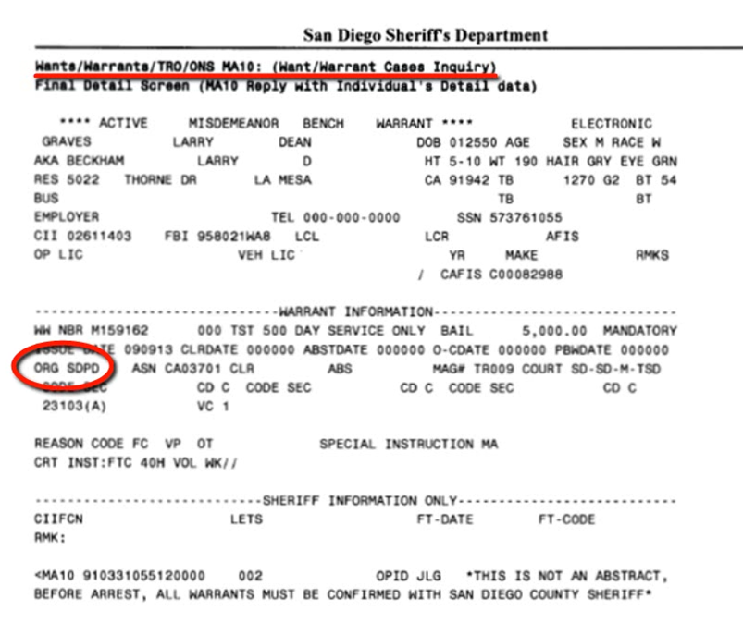
Verifying the Originating Agency

Slide 8
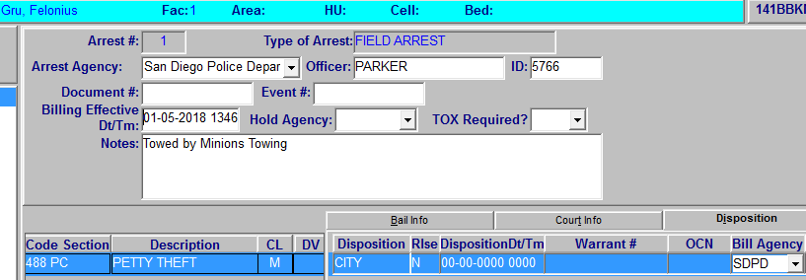
CITY Incarcerated person Dispo in JIMS

Slide 9
CITY Incarcerated persons rules are applied to each arrest individually. There will be times when one arrest will be CITY and the other will not.

Slide 10
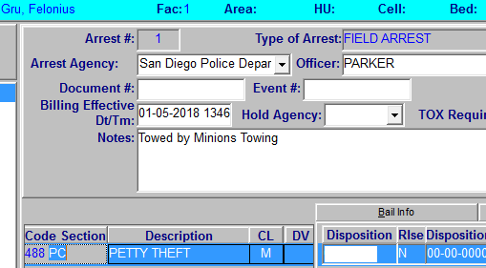
Post-arraignment
Once an incarcerated person has been remanded, sentenced, or released from custody they are no longer considered a CITY incarcerated person.

Slide 11
CITY Incarcerated Person Handout
Read each scenario and identify if it qualifies as a “CITY”.
Give a brief explanation why or why not.

Slide 12
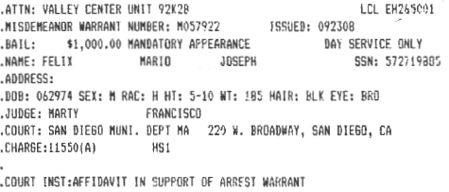
Identifying CITY Incarcerated Persons
Example 1 - Felix

Slide 13
Example 2 - Salgado

Slide 14
Example 3

Slide 15
Example 4

Slide 16
Example 5 - Smith

Slide 17
Exercises
Exercises
Becker
Doe
Guzman
Nguyen
Parks
Seppi
Soper

Slide 18
Exercises
Becker
Doe
Guzman
Nguyen
Parks
Seppi
Soper

