Slide 1
Advanced Phase
Day Three

Slide 2
Day 3 Sentence Calculations
Foote
Vargas
Bedolla, ADA

Slide 3
Day 3 Sentence Calculations
Leeon
Boyce
Sutil
Holt
Brown

Slide 4
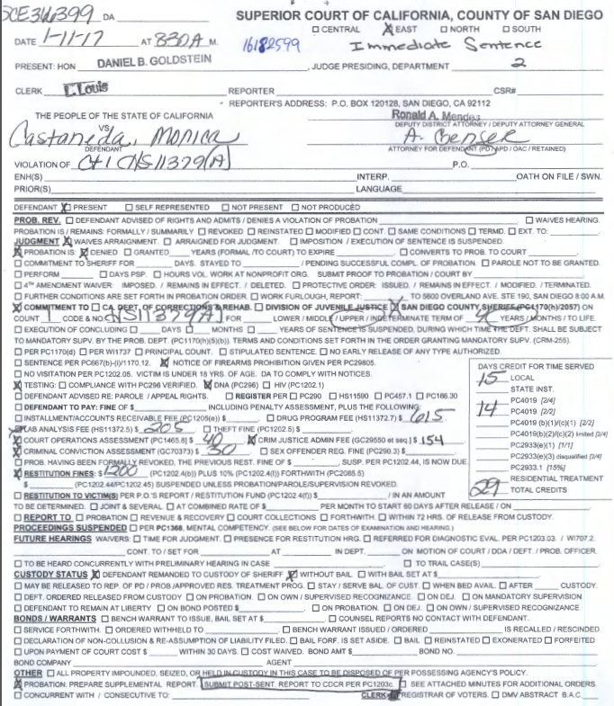

Slide 5
JIMS
Local Prison Commit 4 yrs/29 TCC 2/2
Awt Pkg (today's date)
1170
LPAP

Slide 6
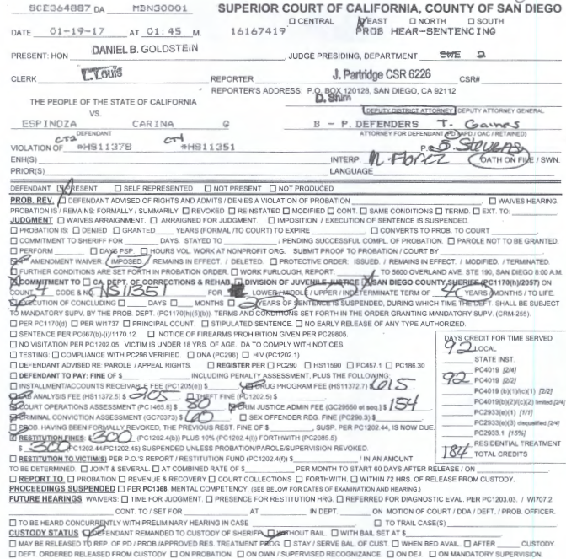
Example #2:

Slide 7
JIMS
Local Prison Commit 4 yrs/2 yrs susp/184 tcc 2/2
Awt Pkg (Today's date)
ICS
ICS
LPAP

Slide 8
Day 3 Sentence Calculations
Norton
Cohen
Jensen
Bennett
Ramos

Slide 9
Day 3 Sentence Calculations
Norton
Cohen
Jensen
Ramos

Slide 10
Day 3 Sentence Calculations
Mendez
Ramirez
Worm
Bedolla, Male

Slide 11
Day 3 Sentence Calculations
Mendez
Worm

