Slide 1
Day 2

Slide 2
Resources
Who’s in Jail
Daily Release Schedule
Bail-Out Schedule for Superior Court Warrants
California Department of Insurance
Notary Public Lookup

Slide 3
Bail Outs
Who can bail an incarcerated individual out?
Bail Bondsman
Family member/Friend
Him/Herself
What are some rules regarding Bail Outs?
Bail cannot be processed the same day of court
DIA’s cannot refer bail agencies
A list of bail agencies can be found throughout every facility
Bail Agents can only remove funds from an incarcerated individual’s account for bail purposes

Slide 4
Types of Arrests
Field Arrest
Municipal Court Warrant
Superior Court Warrant
Drug Court Warrant
Out of County Warrant
Out of State Warrant

Slide 5
Bail-Out Scheduling
Daily Release Schedule
Field Arrest
1551.1 PC - Out of State Warrant
Bail-Out Schedule for Superior Court Warrant
Superior Court Warrants
SCD, SCE, SCN, SCS
Out of County Warrant
Other
SDF
10 calendar days @ 0900
Orange County @ 0800
Municipal Court Warrant
FP
COTP
Drug Court Warrant

Slide 6
Bail
1275
1275.1
Bail Increase/Reduction
Form J-107
.88 gotta wait (pending)
.44 out the door (approved)
Approval from the court
Not feloniously obtained
Bail Flag: P

Slide 7
Bond Types
Professional Bail Bond
Cash Bail

Slide 8
Professional Bail Bond
Completed by a Bail Bondsman
Used to pay a percentage of the bail amount
No refunds on bail fees

Slide 9
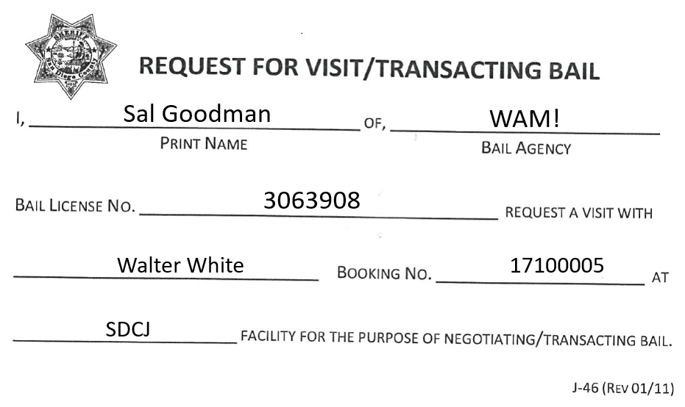
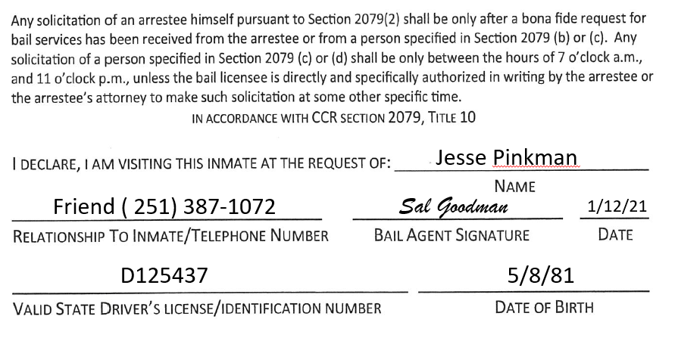
J-46 Request for visit/transacting Bail
A J-46 Request for Visit/Transacting Bail must be filled-out for every transaction

Slide 10
Bail Agent Cards
Bail Agents must provide three forms of identification
Valid Driver’s License/Government Issued ID
Department of Insurance ID Card
Blue Bail Agent Card

Slide 11
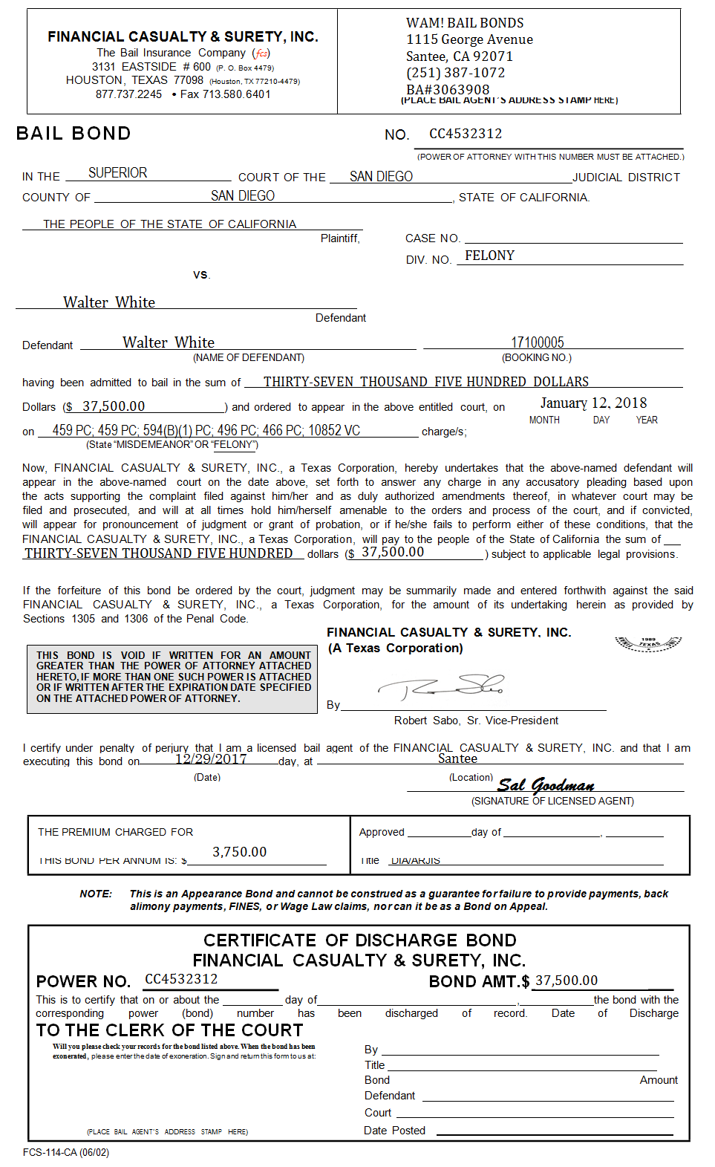
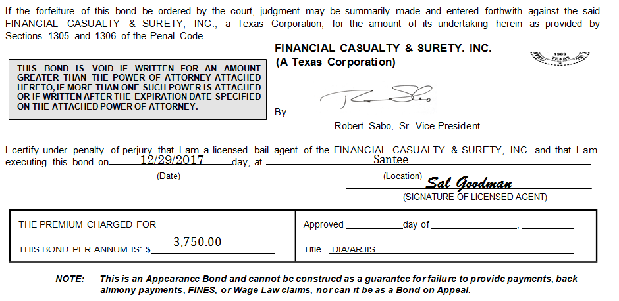
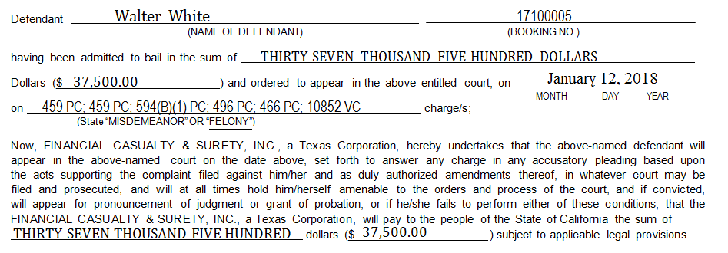
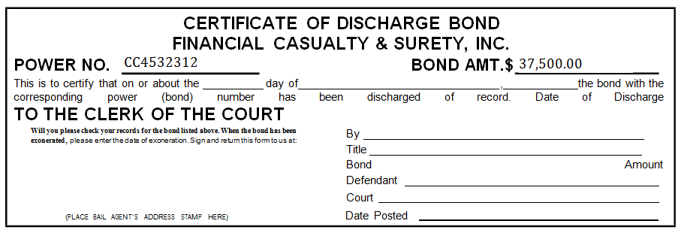
Bond Paperwork

Slide 12
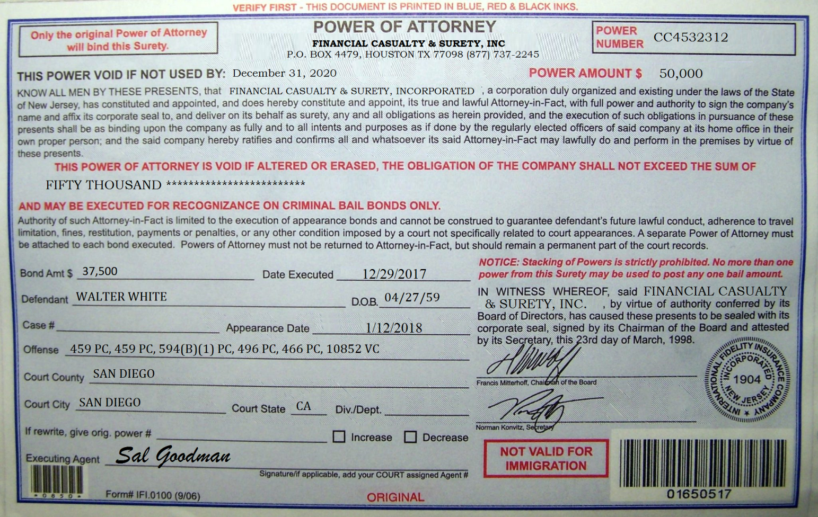
Power of Attorney

Slide 13
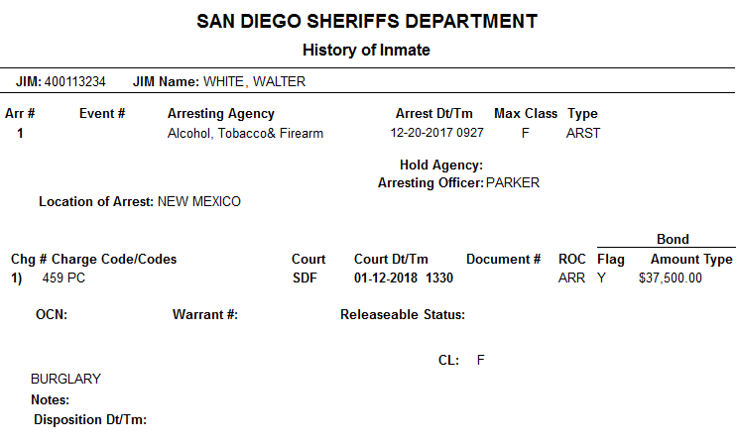
Court Date Change

Slide 14
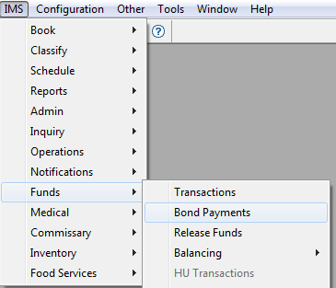
Processing a Bail Bond
To access: IMS > Funds > Bond Payments

Slide 15
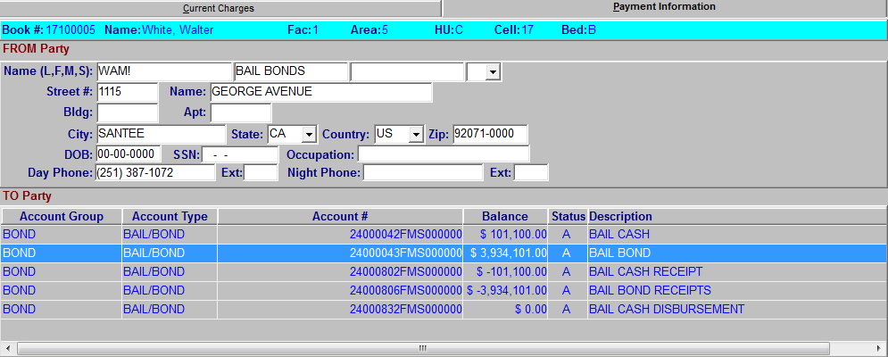
Processing a Bail Bond
Note: Always save from this page

Slide 16
Processing a Bail Bond
5766

Slide 17
Cash Bail
Used when the full bail amount can be paid in cash/check/etc.
Valid Identification is required
IRS Form 8300
To be submitted for payments in excess of $10,000
A refund is returned 90 days after the incarcerated individual’s LAST court hearing
Questions regarding refunds can be routed to:
Accounting office: (619) 450-7034

Slide 18
Acceptable forms of Payment
Cash
Check
Only for misdemeanor offenses up to $300
Cashier’s Check
Accepted during banking hours
Money Orders
Must be deposited into the incarcerated individual’s account and processed as a self bail

Slide 19
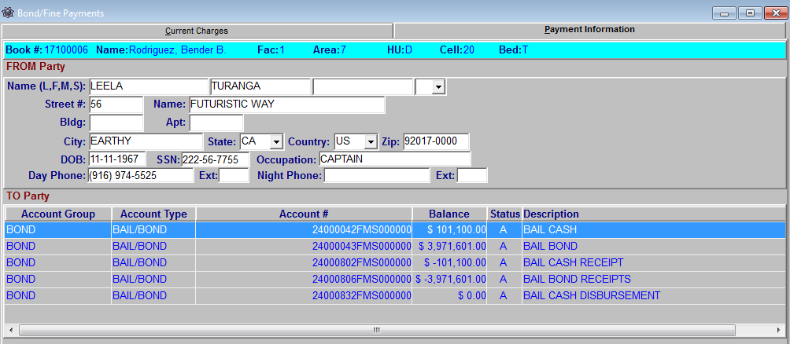
Processing a Cash Bail

Slide 20
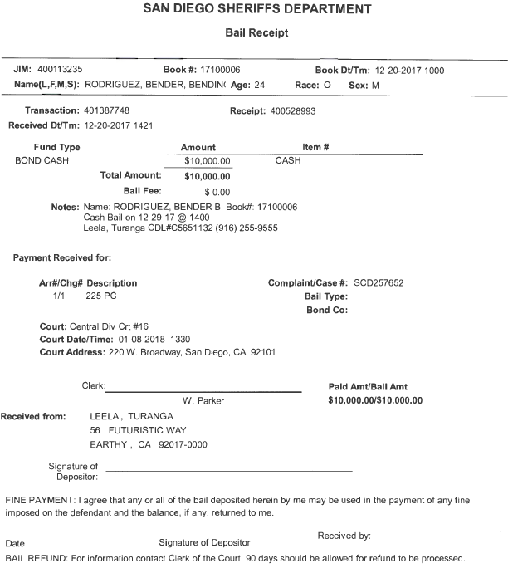
Processing a Cash Bail
5766

Slide 21
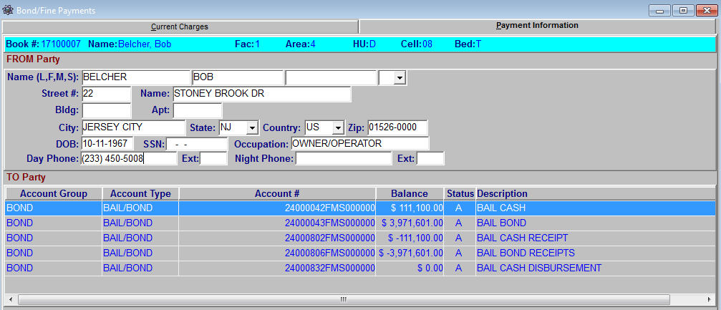
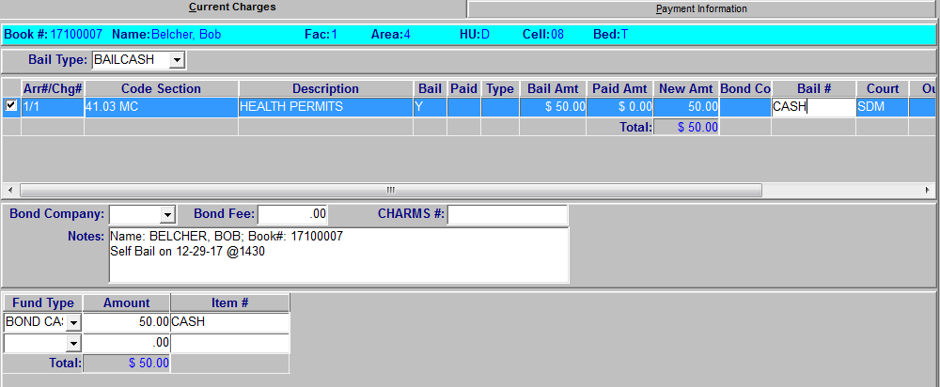
Processing a Self Bail
Authorization for Cash Disbursement (J-50)
Processed similar to a Cash Bail

Slide 22
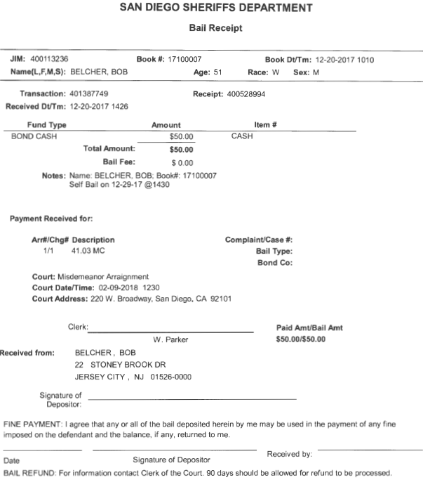
Processing a Self Bail
5766

Slide 23
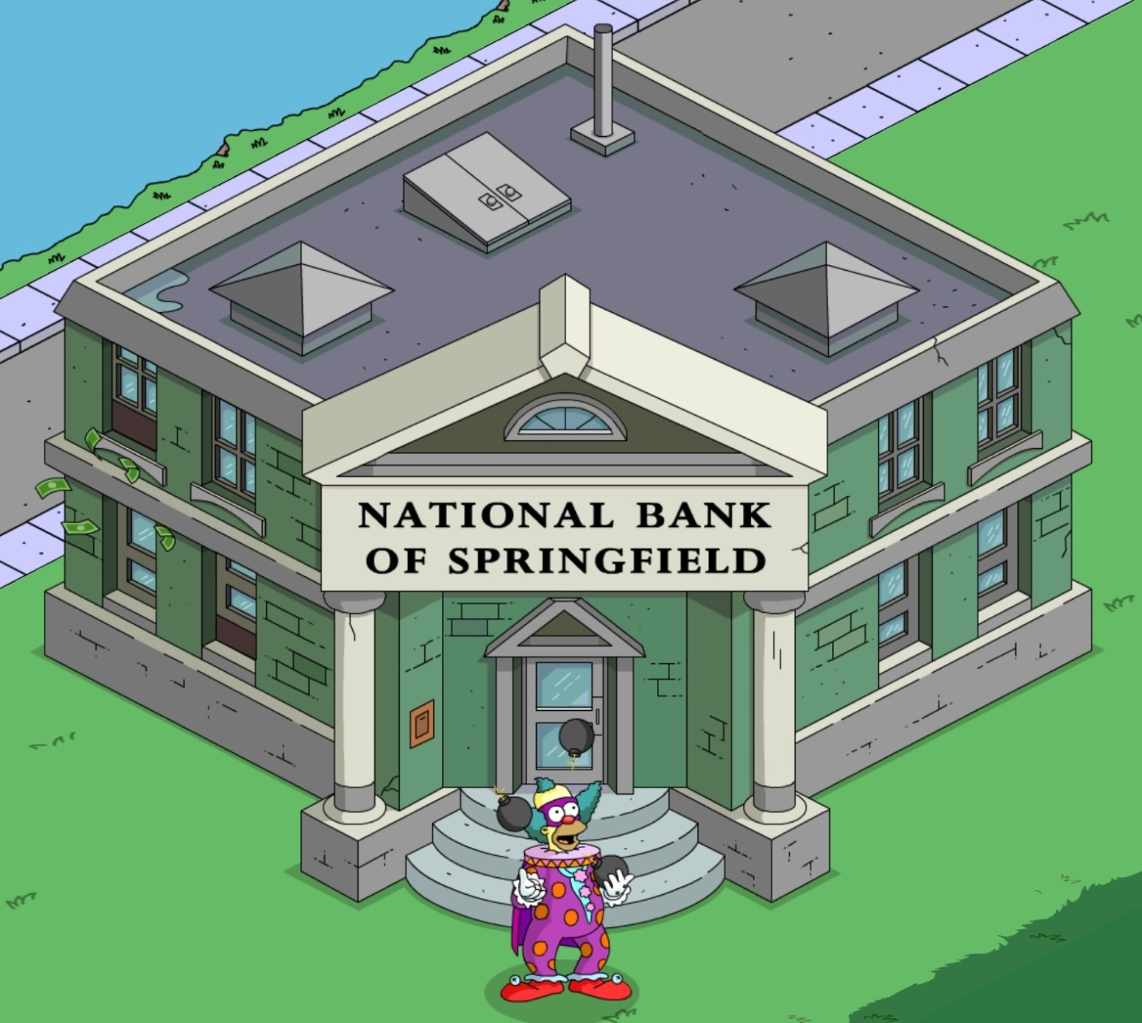
Exercises
Banner
Benitez
Ensign
Flanders
Gru
Maximoff
Mulder
Odinson
Rogers
Stark

Slide 24
Authorized Personnel
Sworn
Professional Staff
Attorneys/Public Defenders
Bail Agents
Clergy
Parole Agents
X-Ray Technicians
County Employees
Programs (must renew access)
AA
NA
Can you name a few?

Slide 25
Professional Visitors
Who are they?
Individuals that require visits with inmates in order to conduct official business
Do not need to schedule a visit
Must adhere to hours of operation

Slide 26
J-4 Visitor Log
What is it?
A log of professional visitors that enter our facilities
How is it maintained?
Every professional visitor that enters and leaves our facility, or visits our inmates must be recorded
To access: V:\Detention Services Bureau
Locate Facility > Open Visitors Log

Slide 27
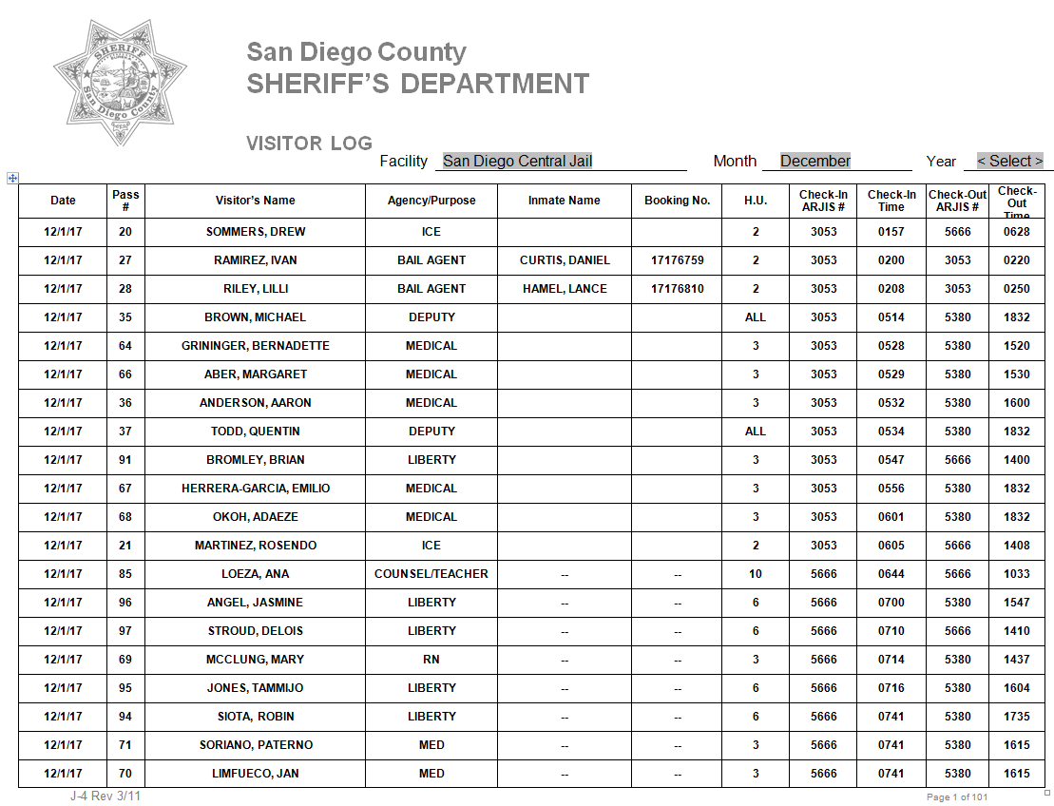
J-4 Visitor Log

Slide 28
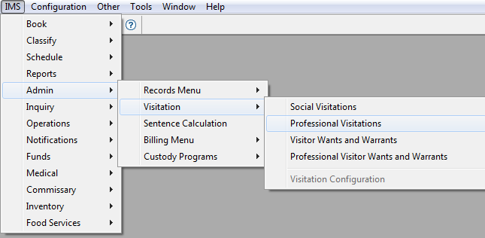
Scheduling Professional Visits
To access: IMS > Admin > Visitation > Professional Visitations

Slide 29
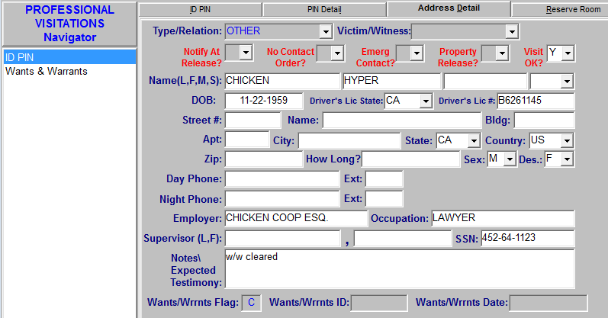
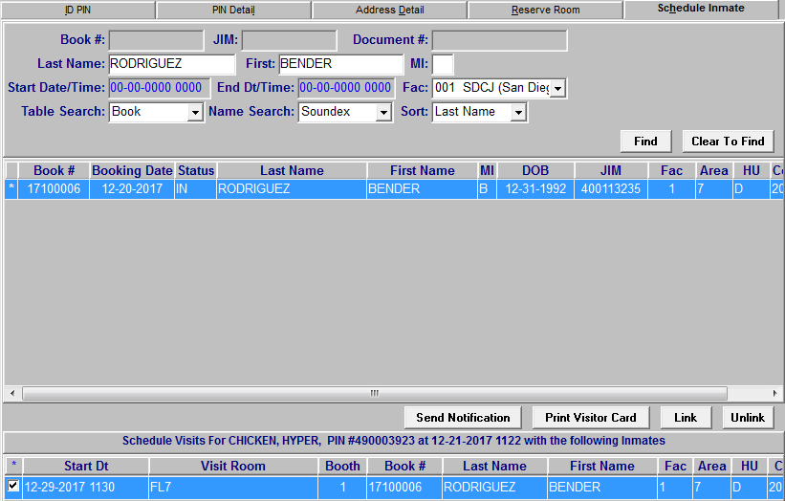
Scheduling Professional Visits

Slide 30
Professional Visitor Pass

Slide 31
Sealed Court Orders
Any court order received at any detention facility, with a notation that it be “sealed” and remain “confidential” is directed to the on-duty watch commander.

Slide 32
Exercises
Thomas
Diaz
Mendez
Saenz

