Slide 1
DIA Phase Answer Key
Day 2 – Bail Bonds

Slide 2
Banner – Bail Previously Posted
Missing Case Number

Slide 3
Banner – Bail Previously Posted
Bail amount must be changed
"Bond previously posted…" verbiage must be added

Slide 4
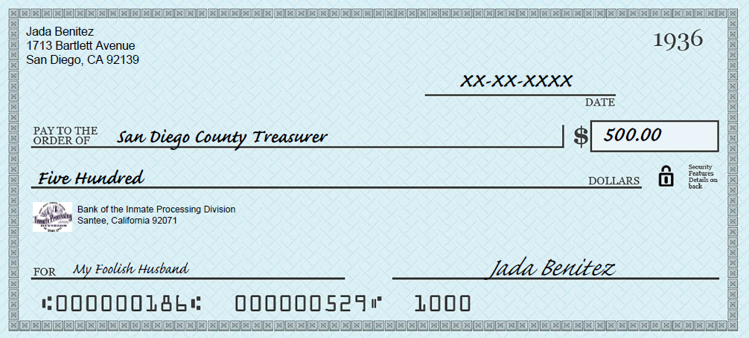
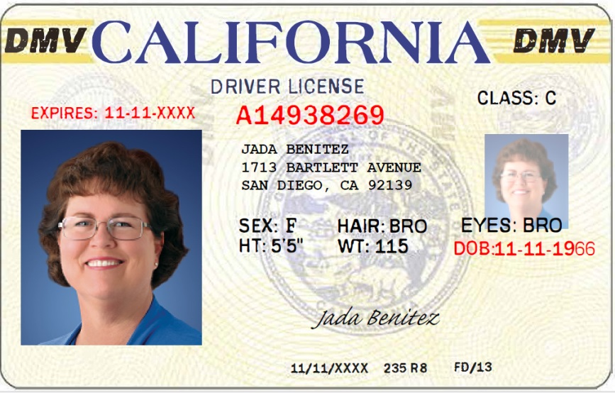
Benitez – Cash (Check) Bail
Checks in excess of $300 are not permissible

Slide 5
Ensign – Out of County
Court date is 10 calendar days @ 0800 (orange county only; all others are 0900).
Court location is OTHR

Slide 6
Ensign – Out of County
ERROR – Power number incorrect
ERROR – Case number missing

Slide 7
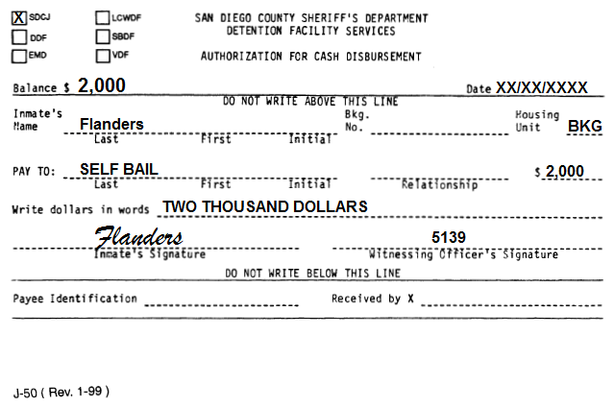
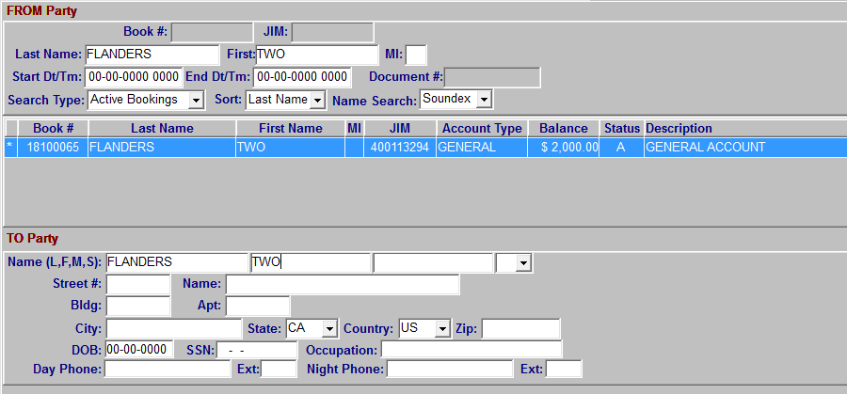
Flanders – Self Bail
Inmate Withdrawal prior to posting bond
J-50 needs to be completed
From and To party is the inmate

Slide 8
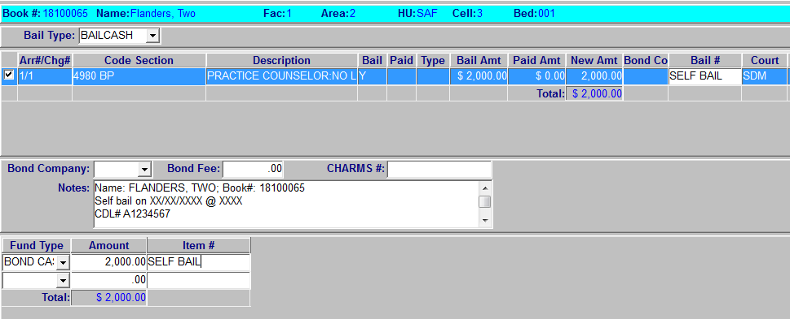
Flanders – Self Bail
Bail Type is Bail Cash
Account type is Bail Cash

Slide 9
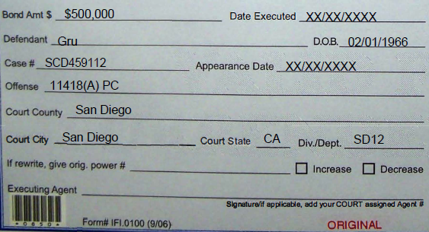
Gru – Superior Court
Court Date is per Superior Court Scheduling
ERROR – missing signature

Slide 10
Maximoff - FP
Court date is to stand
ERROR – Missing signature

Slide 11
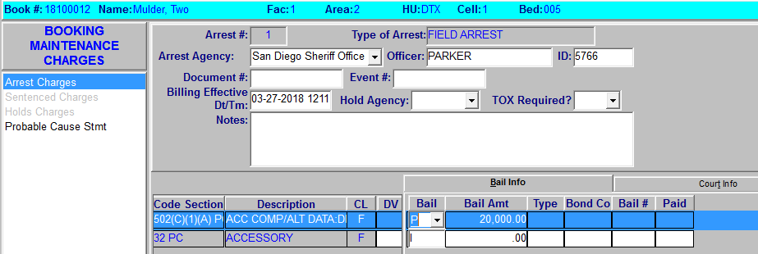
Mulder – 1275.1
Bail per 1275.1 – bond cannot be completed

Slide 12
Odinson
No Bail– bond cannot be completed

Slide 13
Rogers
Bail Type is BAILCASH

Slide 14
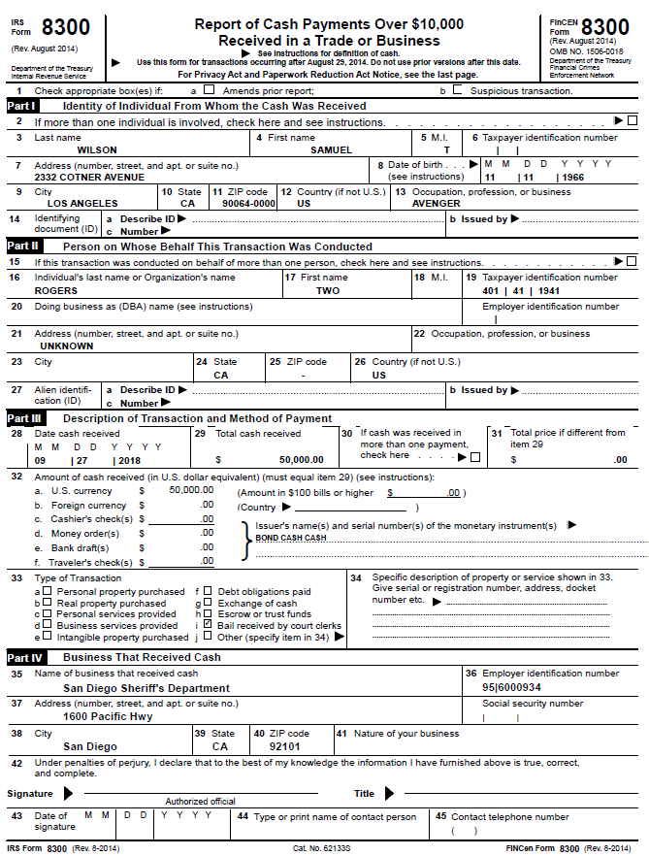
Rogers
Cash Bail in Excess of $10,000 needs an IRS Form
Manually input ID number
Fill-out section 42-45

Slide 15
Stark - Regular
ERROR – Expired power

