Slide 1
New Employee Orientation
DPD Training Unit

Slide 2
Slide title 6
Name
Position
Facility
Shift
Me!
“Before I worked for DPD, I…”

Slide 3
New Employee Forms and Access
JIMS Access
PC and Email
Kronos
LMS
People Soft
IPD Employee Data Sheet
Contact Log
Facility Access
Com 10 / Com 11

Slide 4
Slide Title 1
DSB Classifications
Kelly Martinez
Undersheriff
Rich Williams
Commander
Charles Cinnamo
Commander
Anthony Ray Sheriff
Theresa Adams-Hydar
Assistant Sheriff
Christopher Buchanan
Commander
Carl Darnell
Captain – SDCJ
Gloria Soto-Meza
Captain – GBDF
Rodrick Smith
Captain – LCDRF
Dody Patterson
Captain - EMRF
Sonia Manning
Captain - VDF
Kelly Buchanan
Lieutenant - SBDF

Slide 5
Slide Title 1
DPD Classifications
Assistant Manager
Sheriff’s Operations Supervisor - SDCJ
Sheriff’s Operations Supervisor – GBDF/EMRF
Admin Detention’s Processing Supervisor - SBDF
Manager
Admin. Secretary II
Sheriff’s Operations Supervisor - VDF
Sheriff’s Operations Supervisor - LCDRF
Sheriff’s Operations Supervisor – Training Unit/Pre-trial
Detention's Processing Supervisor (8)
Detention's Processing Supervisor (2)
Detention's Processing Supervisor (5)
Detention's Processing Technician (54)
Detention's Processing Technician (8)
Detention's Processing Technician (4/8)
Detention's Information Assistant (12)
Stock Clerk (5/4)
Detention's Information Assistant (2)
Stock Clerk (1)
Detention's Information Assistant (12)
Stock Clerk (5)
Detentions Processing Supervisor (5)
Detentions Processing Technician (35)
Detention's Processing Supervisor (1)
Detention's Processing Technician (29)
Detention's Processing Technician (2)
Detention’s Information Assistant (18)
Stock Clerk (6)
Stock Clerk (11)
Detention's Information Assistant (22)

Slide 6
What each Classification does…
DPS – Detentions Processing Supervisor
Supervisor for DPT’s, DIA’s, Stock Clerks
DPT – Detentions Processing Technician
Process incoming arrests, court paperwork, releases
Can be assigned to work at 6 to 8 different spots (Facility/Shift)
DIA – Detentions Information Assistant
Public inquiries , process visitors/bonds/cashier drawer
SC – Stock Clerk
Process incoming/outgoing property

Slide 7
Slide title 7
SOS
DPS
Trainer
YOU
Assistant Manager
Manager
Chain of Command

Slide 8
We provide the highest quality detention processing and customer service to the community
Mission Statement
Honesty, Integrity, Loyalty, Trust, Respect, Fairness Diversity and Compassion
Core Values

Slide 9
Dress Code
Casual slacks
Denim pants (no blue jeans)
Long or short sleeved shirts
Sweaters
Polo shirts
Sweatshirts
Dresses
Blouses
Dress shoes
Athletic shoes
Hiking boots
All clothing must be clean without holes or fraying and not overly distressed

Slide 10
Casual Friday/Weekends/C-Shift
Casual slacks
Capri pants (shorter than mid-calf unacceptable
Sports shirts
Sweatshirts
T-shirts
Skirts
Dresses
Blouses
Sweaters
All clothing must be clean without holes or fraying and not overly distressed

Slide 11
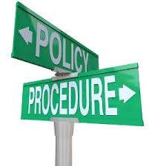
Policy and Procedure 2.20
“All employees shall furnish their first and last name or ARJIS number to any person requesting his or her identity”

Slide 12
Policy and Procedure M.5 – Taking appropriate action
If you witness a medical emergency…
Notify sworn/medical staff immediately”

Slide 13
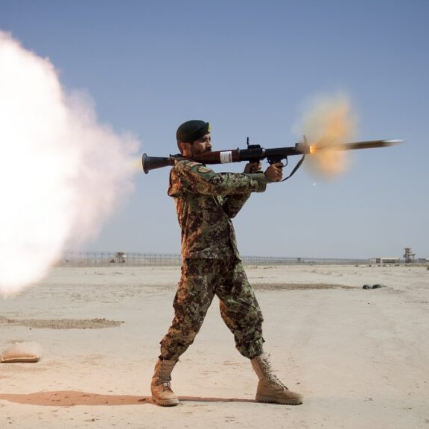
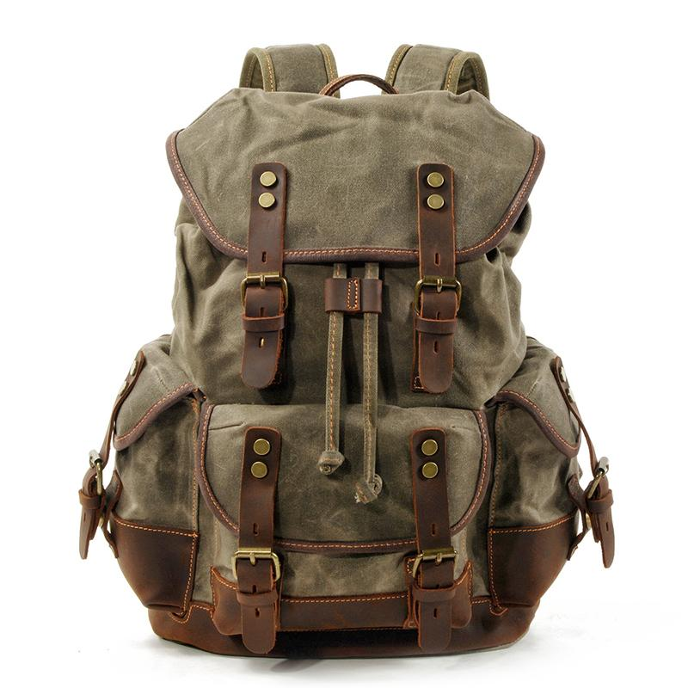
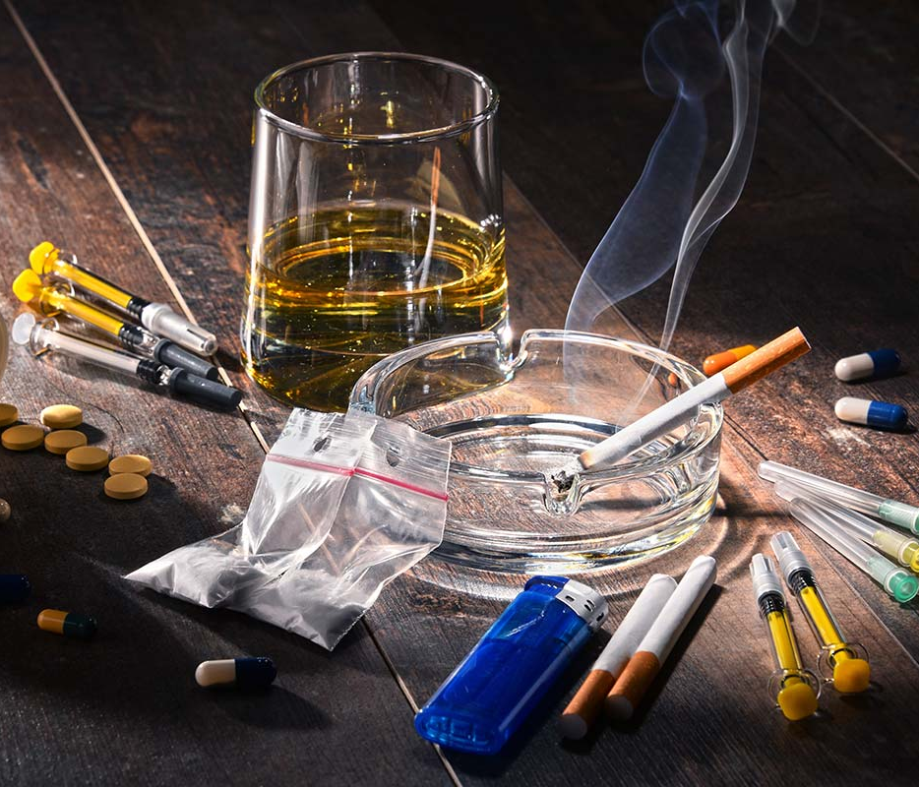
Contraband
Weapons
Drugs
Lighters
Incendiary items (bombs/ammo/vapes)
Cigarettes
Laptop/Tablet
Bulk Property
Perishable Goods

Slide 14
Slide title 8

Slide 15
SAN DIEGO CENTRAL JAIL
1173 Front Street
San Diego, CA 92101

Slide 16
GEORGE BAILEY DETENTION FACILITY
446 Alta Road
Suite 5300
San Diego, CA 92158

Slide 17
EAST MESA REENTRY FACILITY
446 Alta Road
Suite 5200
San Diego, CA 92158

Slide 18
FACILITY 8
446 Alta Road
Suite 5300
San Diego, CA 92158

Slide 19
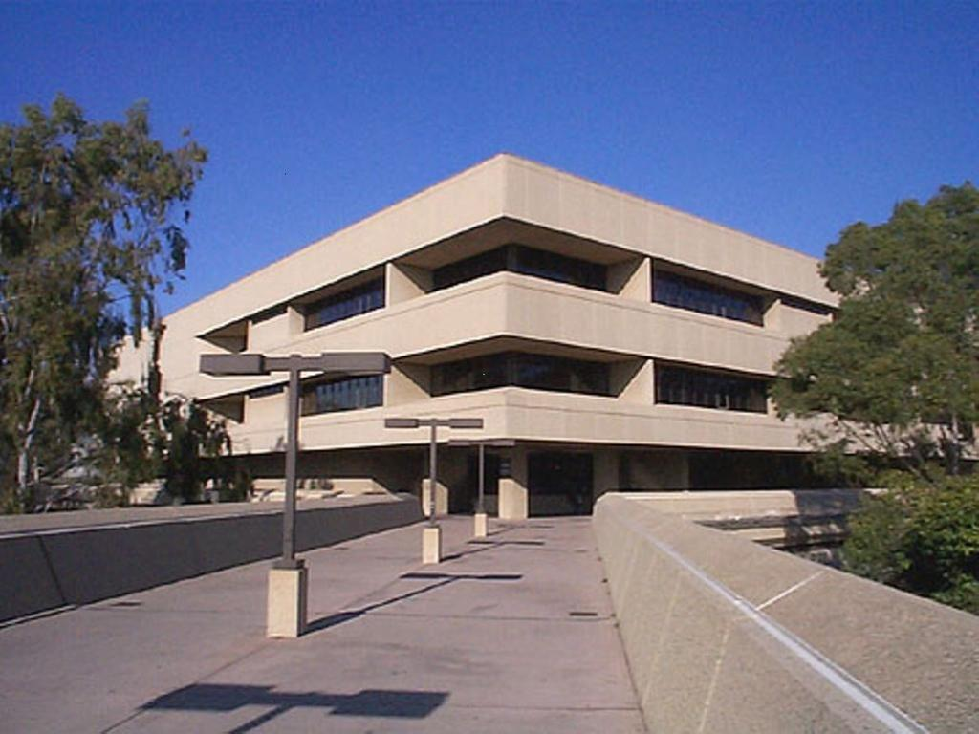
SOUTH BAY DETENTION FACILITY
500 Third Avenue
Chula Vista, CA 91910
Supervisor: (619) 691-4429
Information: (619) 691-4817
Booking: (619) 691-4626

Slide 20
VISTA DETENTION FACILITY
325 S. Melrose Drive
Suite 200
Vista, CA 92081

Slide 21
LAS COLINAS DETENTION & REENTRY FACILITY
451 Riverview Parkway
Santee, CA 92071

Slide 22
How to Log-in
E-mail
JIMS
PCD
SDLaw
Kronos
Uploading COVID Vaccination Record

Slide 23
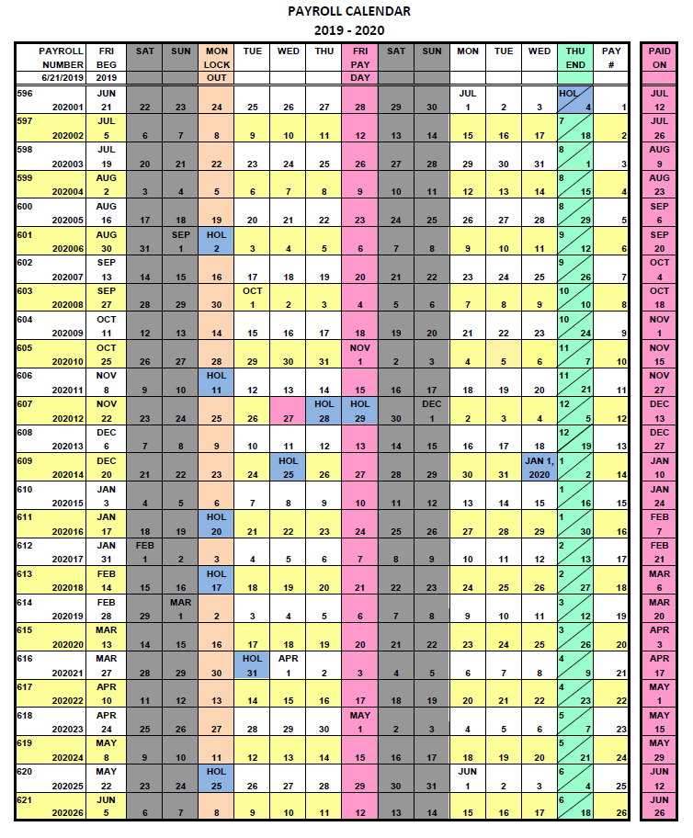
Requesting Time Off

Slide 24
Common Pay Codes
VAC – Vacation
CTO – County Time Off
FHO – Floating Holiday
SLP – Sick Leave, Personal
SLO – Sick Leave, Other

Slide 25
Property of San Diego Sheriff’s
No Expectation of Privacy

Slide 26
Slide title 5
Your Corporate Directory

Slide 27
(U:) Drive

Slide 28
Employee Expectations
You are expected to be in attendance on your regularly scheduled workdays.
Teamwork
Work together as a team.
Dress Code
We will comply with the Departmental and facility dress code guidelines.
Punctuality
Personal Activities
Access & ID
Communication
Attendance
Rules of Conduct
Chain of Command
Sheriff’s Identification cards will be worn, in plain view at all times.
Complaints and/or grievances will be resolved beginning at the first level of supervision
Everyone is required to abide by the Department’s Rules of Conduct, Policies, Procedures, and Core Values.
Personal activities should be conducted afterwork hours or during lunch and breaks.
Open communication is the key to maintaining an efficient, negative free work environment
Being on time to work is very important and a must.

Slide 29
Station File and Training File
Every new employee will have a Station and Training File
Station File
New employee Forms
Expectations
Contact Log
Monthly Training Evaluations
Accolades/ discipline
Purged annually
Training File
Progress Reports
Training Development Reports
Documentation of Errors
Forwarded to the Training Unit once training is complete

Slide 30
Contact Log
Located in the station file
Essential to documenting communication between the employee and the supervisor
Documents when evaluations are provided
purged annually unless ongoing issues are noted

Slide 31
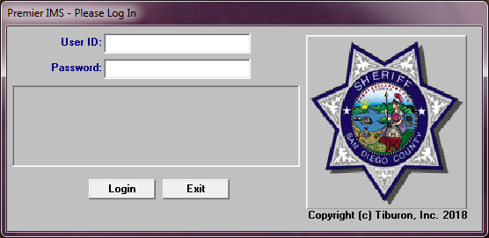
JIMS Capabilities

Slide 32
Familiarize yourself with many of the terms used within DPD

Slide 33
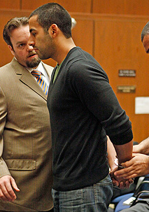
FELIX
FELIX

