Slide 1
Phase III
Day 5

Slide 2
Commitment Information
Custody in lieu of fine
Ex: $700/$50 = 14 Days

Slide 3
What is AB109?
Assembly Bill 109 originated by an order from the United States Supreme Court to reduce state prison population.
This legislation and Penal Code 1170(h) allows imprisonment in a county jail.

Slide 4
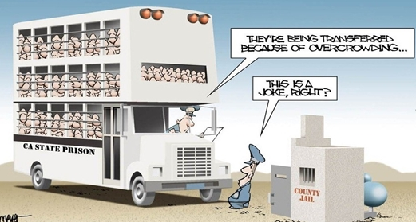
California Penal Code 1170(h) subsections:
(h)(1): 16 months, 2 years or 3 years imprisonment in county jail
(h)(2): Imprisonment in county jail for the term described in the underlying offense
(h)(5): Split sentence – Ex: 3 years with 2 years to be served under mandatory supervision

Slide 5
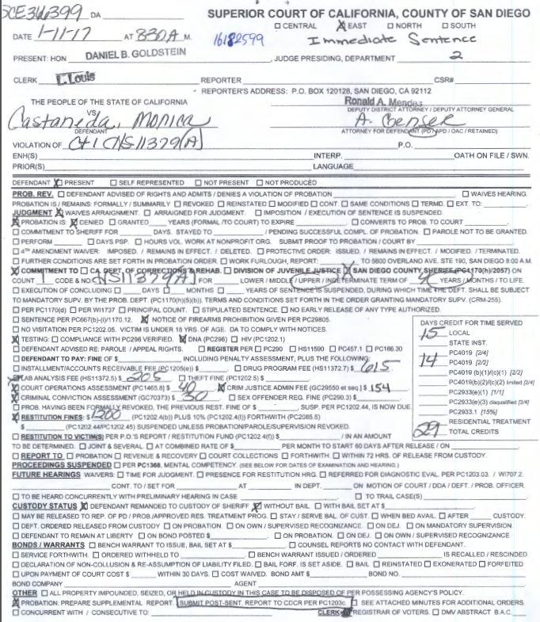
Example #1:

Slide 6
JIMS
Local Prison Commit 4 yrs/ 29 TCC / 2/2
1170
LPAP

Slide 7
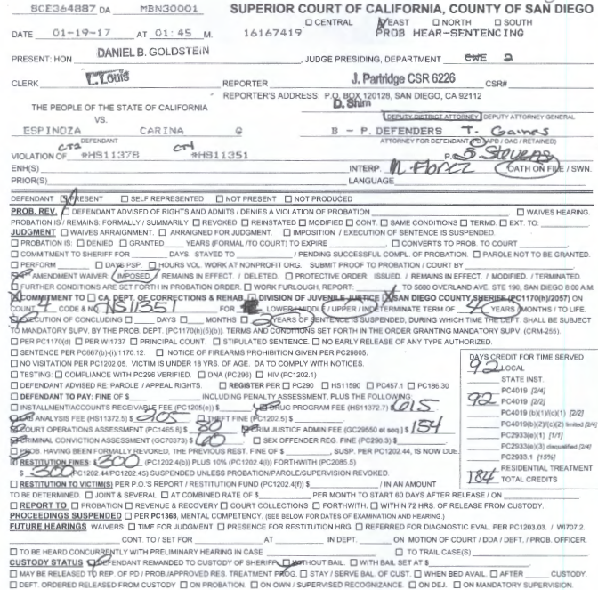
Example #2:

Slide 8
JIMS
Local Prison Commit 4 yrs/2 yrs susp/184 tcc 2/2
Awt Pkg (Today's date)
ICS
ICS
LPAP

Slide 9
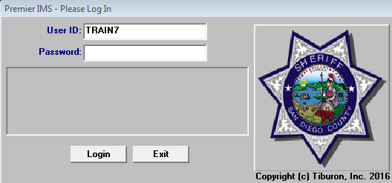
Exercises
**JIMS Login-User: Train & Terminal Number Ex: Train7
**When updating the 1st name of your incarcerated person will be your terminal number.
Ex: Diaz, Seven

Slide 10
Exercises
PEREZ, ELISEO
VARGAS ESTEBAN
BEDOLLA, MALE
BEDOLLA, ADA
NORTON, EDWARD
COHEN, RICHARD
MENDEZ, RAUL

Slide 11
Exercises – (Advanced DPT)
BROWN
FOOTE
JENSEN
RAMOS
WORM

Slide 12
Exercises
BEDOLLA, ADA
NORTON, EDWARD
BEDOLLA, MALE
COHEN, RICHARD
MENDEZ, RAUL

