Slide 1
Phase III
Day 3

Slide 2
Commitment Calculations
County/Local Time
AB109 (1170 & ICS)
State Prison (CDCR)

Slide 3
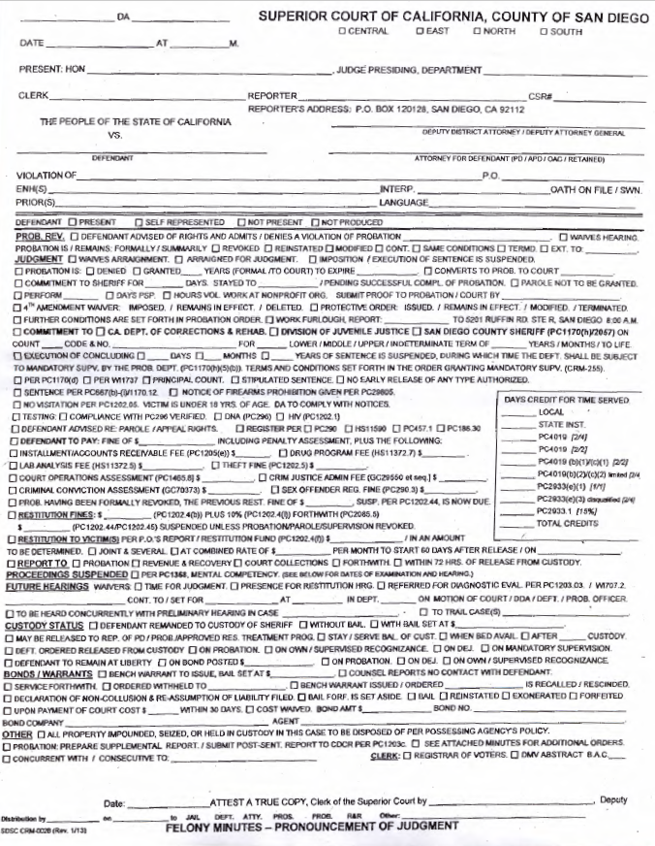
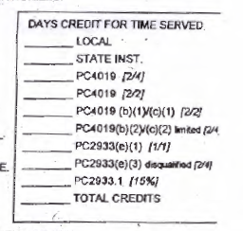
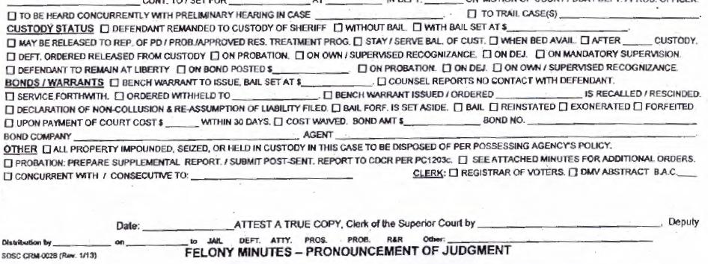

Slide 4
Court Information
Execution/Imposition of commitment Suspended
No Early Release, No County Parole & No Work Release
Stayed
Concurrent
Nunc Pro Tunc

Slide 5
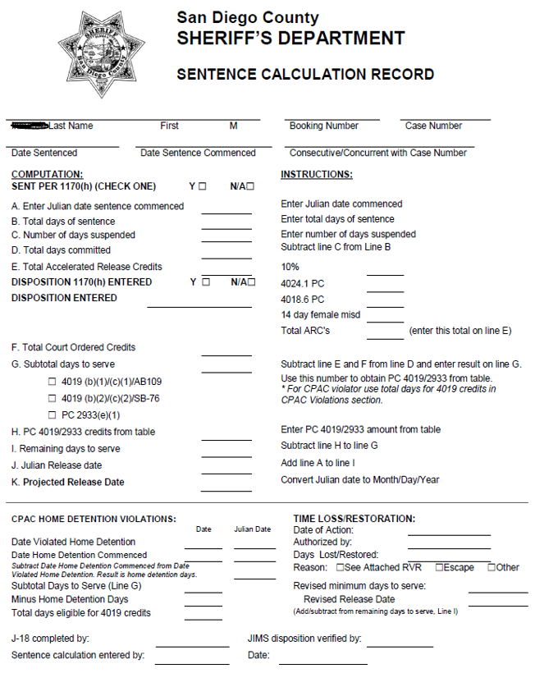
J-18 Sentence Calculation Record

Slide 6
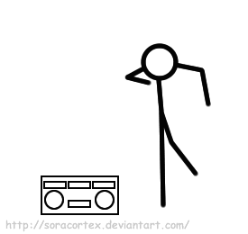
Exercises
ROPER, DIANA
PALMER, DAVID
LEEON, ELAINE
LAPAN, JEROME
RAMIREZ, SEBASTIAN
SALAZAR, DANIEL
STUBBLEFIELD, DORIS
BOYCE, KEVIN

Slide 7
Exercises Part II
RICO, DAVID
SCIMECA, RONALD
SHIELDS, SALLY
HERNANDEZ, JOSEPH

Slide 8
Exercises
**When updating the 1st name of your incarcerated person will be your terminal number. Ex: Diaz, Seven
ROPER, DIANA
PALMER, DAVID
LEEON, ELAINE
LAPAN, JEROME
SEBASTIAN, RAMIREZ
SALAZAR, DANIEL
STUBBLEFIELD, DORIS
BOYCE, KEVIN
BROWN, RONESHA

