Slide 1
Phase III
Day 1

Slide 2
Ground Rules
Please arrive on time
Call or text if you are running late
No cell phone
No internet/e-mail
If you have a question, please raise your hand
Do not ask your coworkers
Plenty of breaks

Slide 3
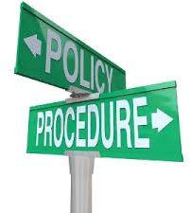
Policy and Procedure M.5 – Taking appropriate action
If you witness a medical emergency…
Notify sworn/medical staff immediately”

Slide 4
Navigation
San Diego Sheriff's Intranet
DPD Web page
Who's In Jail?
SD Law
Superior Court Bail Schedule
Bail Out Schedule for Superior Court Warrants
California Law
DPT Manual
Department P&P
DIA Manual
Detentions P&P
Stock Clerk Manual
Training Bulletins
Sentence Calculation Manual
B.A.C.
Daily Release Schedule

Slide 5
PRE-RELEASE
Responsible for timely & accurate processing of incarcerated persons who are eligible for release.
Each arrest must have a release authorization.
Monitor the Pending Release Queue
Review all paperwork & JIMS to ensure bookings have been processed & accounted for.

Slide 6
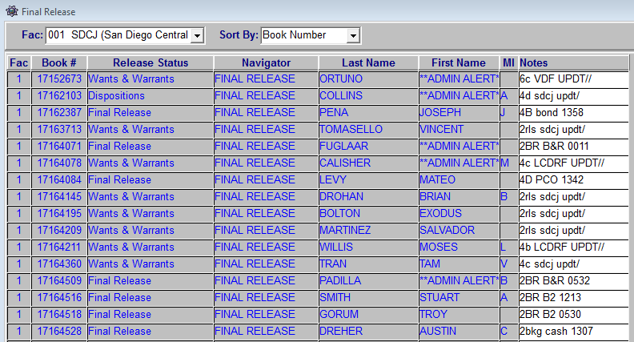
IMS BOOK PENDING RELEASES

Slide 7
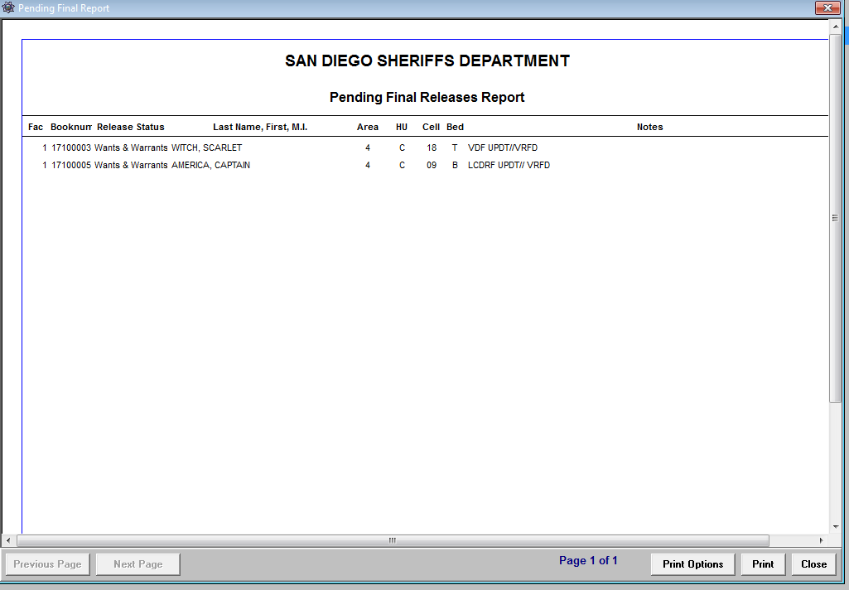

Slide 8
How to Pre-Release
IMS BOOK FINAL RELEASE

Slide 9
Dispositions
Indicate the adjudication or completion of a charge or arrest.
Used as a tracking mechanism.
Becomes a part of the incarcerated person’s Criminal History.

Slide 10
Disposition Types
DISM
ROR
BOND
CASH
CTS
PROB
825
NCDA
B(1)
B(2)
CB&R
CFLR
NINA
LPSC
SPTS
SFLR
DPT MANUAL LINK

Slide 11
Wants & Warrants
Must have 7 Responses or “HITS”.
Confirm & book any of the following warrants:
Felony
Domestic Violence
1209 PC
Commit warrants
Drug Court
Juvenile
Local misdemeanor warrants are cleared and processed with a Notice to Appear Per 853.6 PC Form
Unserved TRO’s are printed & given to the Watch Commander or Processing Sgt.
*DPT Manual

Slide 12
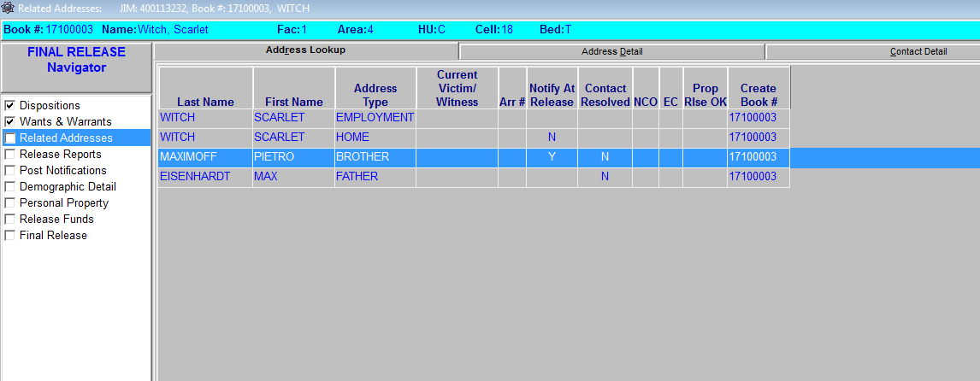
Related Addresses
Is there a “Y” in the Notify at Release field?
Contact must be made or 3 attempts to notify the person listed.

Slide 13
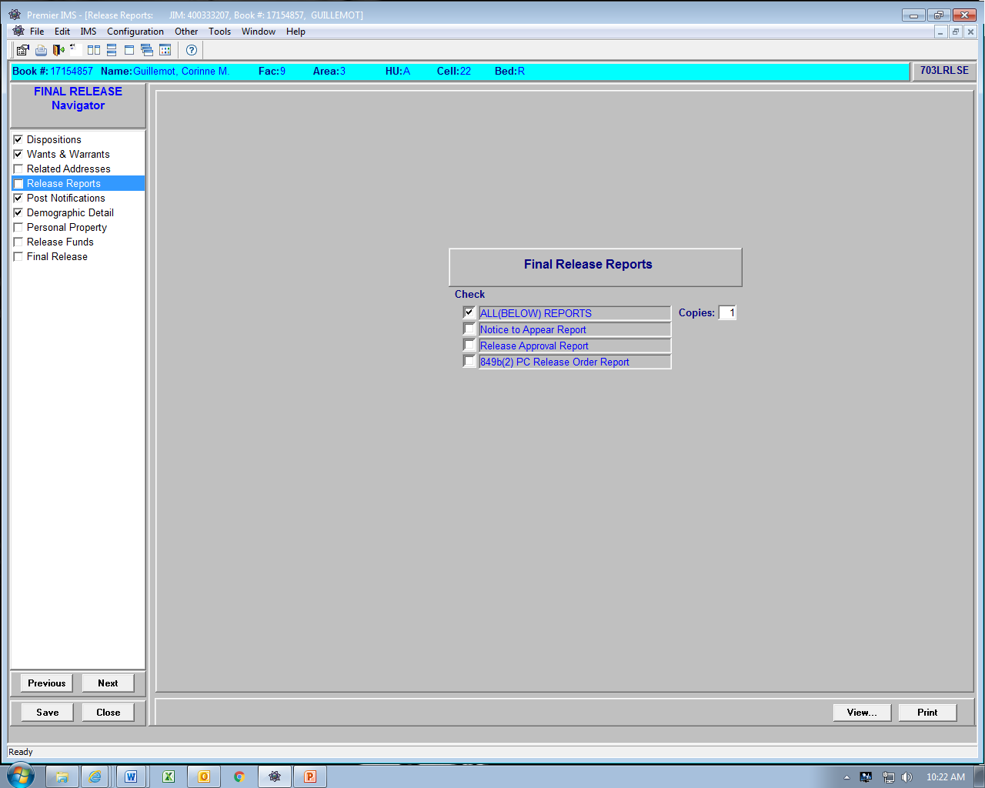
Release Reports

Slide 14
Release Reports – Notice To Appear
Notice to Appear is utilized for B&R’s or Warrants found at Pre-Release
Release Approval is utilized for releases to other agencies, fugitive, etc.
849(B)(2) is utilized for your 647(F)

Slide 15
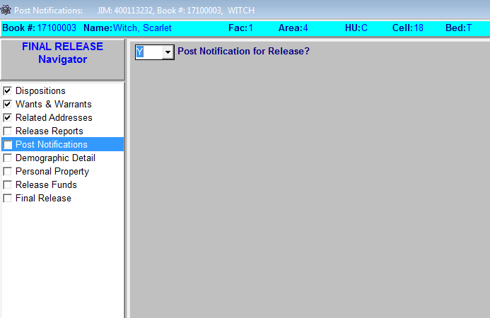
Post Notifications
Post Notification for Release?
Y or N

Slide 16
Demographic Detail Tab
Ensure a “Y” is listed under JIMS Verified.
DOJ DNA Required?
“Y” – DNA Required
“C” – DNA Completed
“N” – DNA Not Required

Slide 17
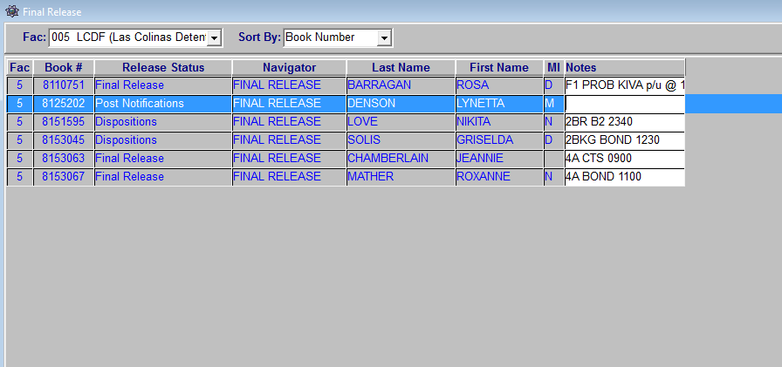
Pending Release Queue
Enter notes into the Pending Release Queue.
Housing location. Ex: 4B
Release type. Ex: BOND
Pre-Release time

Slide 18
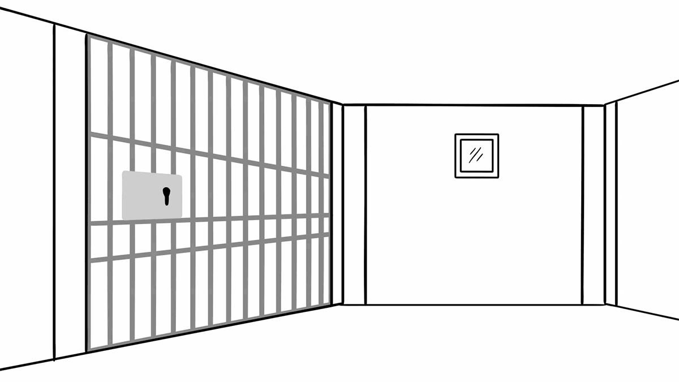
Exercises
ALDAZ
CABRERA
CLARK
DEMBITSKY
DIAZ
HOWE
LOREDO
NAGY
SHINE

Slide 19
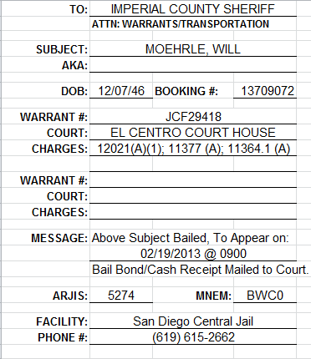
Out of County Releases
Bail Out
-Teletype must be sent to appropriate county.
-DPT Manual – Out of County

Slide 20
Military
Incarcerated persons command wishes to pick up upon release.
Do not hold them past their release
date.
Notify Supervisor if not picked up
within 8 hrs
Military Hold Authorization Form

Slide 21
VINE
VINE PowerPoint
What does VINE stand for?
Victim Information & Notification Everyday
What 2 ways can VINE info & registration be accessed?
Online: www.vinelink.com call: 1-877-411-5588
Upon registering what info is needed?
Offenders name and booking number
True OR False: Vine automated system will continue to call the victim until a 4-digit pin code is entered.
True
Why is it imperative to have the correct Release Type/Release to Agency?
For accurate monitoring of the individual once they are release from county jail.

Slide 22
Special PKUP’s/Releases PCO
Run & process reports
IMS

Slide 23
Event Type
DAPU
GPS
JBCT
LEPU
PKUP
RPCO
TRANS

Slide 24
Exercises
*
DUBON
JUAREZ
MILLER
MORENO
ROSAS
VELASCO
WASHINGTON
WEINAPPLE
WRIGHT

