Slide 1
Phase II
Day 5

Slide 2
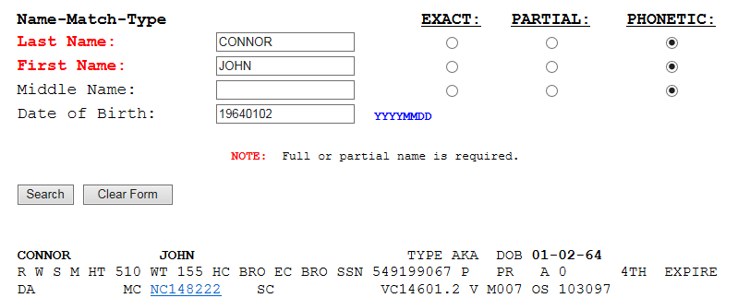
825
End of Court Date List is generated, names of incarcerated individual’s not receiving a court paper/updated are shown
We will pull those custody records and perform a DA09 search in SDLaw to see if the incarnated individual's case was addressed

Slide 3
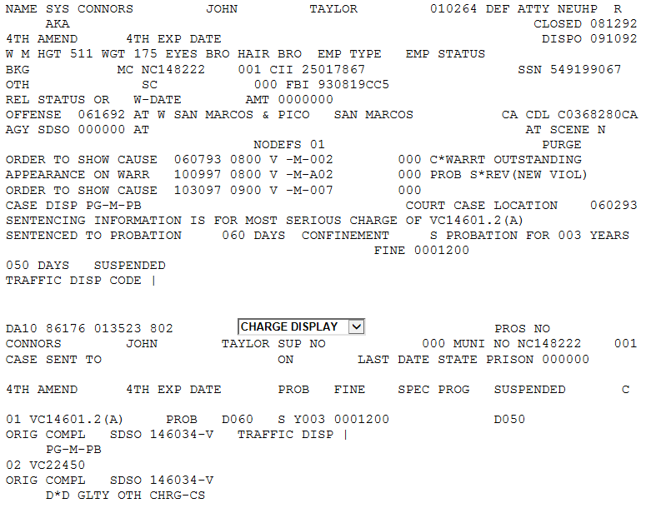

Slide 4
825
825 Packet
Do not 825
J-15
Booking summary w/ ARST# on the 1st page
825 stamped and arjis
Printed copies of the DA09 & DA10 screens
Commit Warrant
1209 Warrants
Felony Warrants
Juvenile Court Warrants
Bail Bond Surrender with a case number

Slide 5
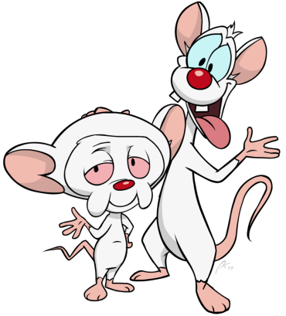
Exercises
Holt
Mena
Rousey
Shine
Roper
Lapan
Boyce
Sutil

Slide 6
Exercises
Norton
Cohen

