Slide 1
Phase II
Day 4

Slide 2
Mental Competency
Determines incarcerated person’s ability to take care of themselves
These hearings suspend all court proceedings
Sent to SUPEF - Psychiatric Examining Facility
Update applicable charges with the FP court date
The last charge will be the mental competency exam with court: SUPEF and ROC: ZE
Enter "Proceedings Suspended per PC 1368" in maintenance notes

Slide 3
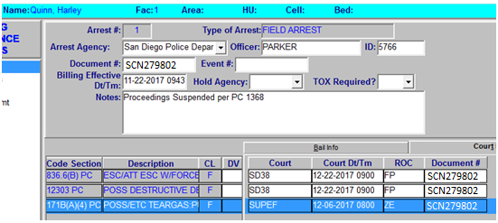
Mental Competency

Slide 4
Mental Competency
Once the paper is received and updated
Scan the court paper and email it to:
Group name: MSD, HIM MHC
Direct email: HIMC_MH@sdsheriff.org

Slide 5
Sentenced to Death or Life in Prison
If Sentenced to Death take the document immediately to the on duty DPS
Notify Classification for the following:
Sentenced to Life in prison
Sentenced to Death
Keep Separate/Protective Custody orders

Slide 6
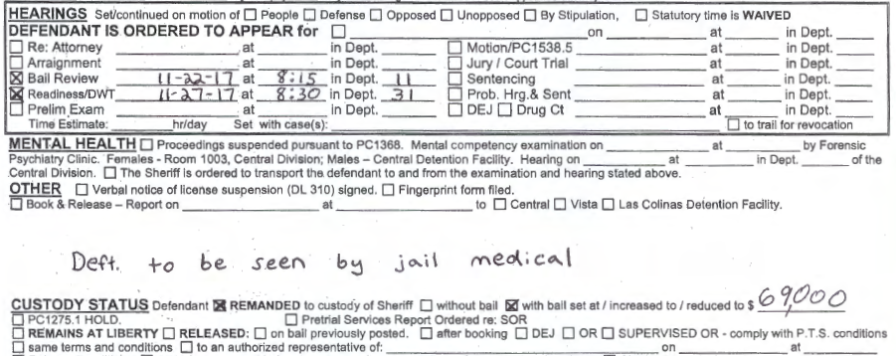
Distribution of Court Orders
Court orders requiring compliance from other personnel must be forwarded
A copy will be made and given to the appropriate person(s) in a timely manner
Note on the court order the distribution. (Ex. CC Med, CC W/C, etc.)

Slide 7
Quality Assurance / Purge
Look at everything!
Compare to what is in JIMs
Arrest, charges, bail, case numbers
Re-work the sentence calculations and compare to JIMS
Run wants and warrants

Slide 8
Purge – Jacket order
Mugshot
J-15/pcd
Arrest #1
Arrest #2
Fluff (safety cell, inmate request, property slips, ect.)
QA sheet

Slide 9
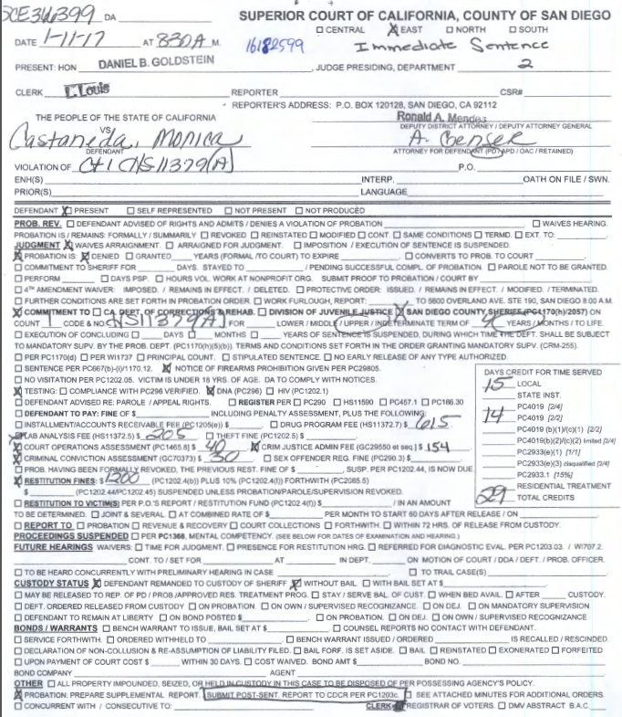
Example #1:

Slide 10
JIMS
Local Prison Commit 4 yrs/29 TCC / 2/2
Awt Pkg (today's date)
1170
LPAP

Slide 11
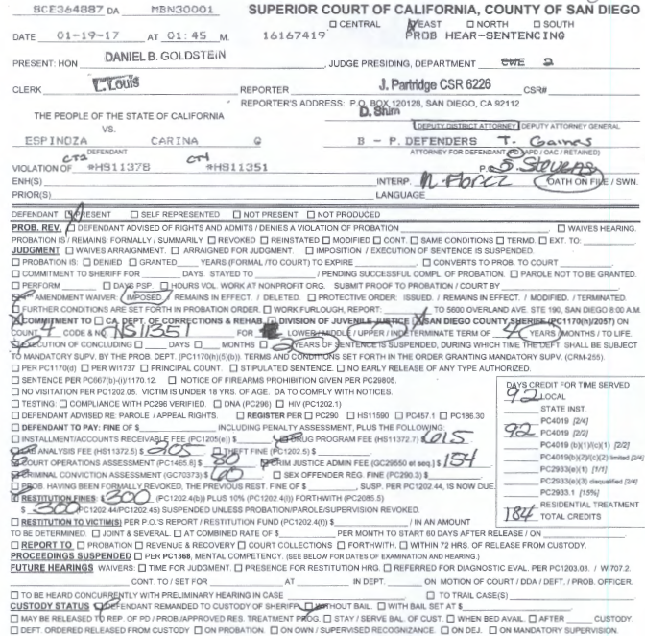
Example #2:

Slide 12
JIMS
Local Prison Commit 4 yrs/2 yrs susp/184 tcc 2/2
Awt Pkg (Today's date)
ICS
ICS
LPAP

Slide 13
Exercises
Applestein
Covarrubias
Day
Demara
Diaz
Foster
Guerrero
Rousey
Templeton
Valencia

Slide 14
Rico
Johnson
Parker
Scimeca

