Slide 1

PHASE II
Day 2

Slide 2

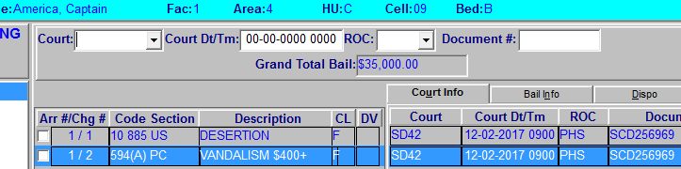
PHS
Probation Hearing and Sentencing- When a verdict is reached the court will generate a minute order indicating the defendant is scheduled for Probation, Hearing and Sentencing

Slide 3
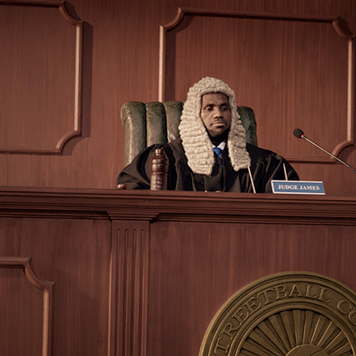
Bail Per 1275.1
Requires that the person posting bail to prove money and security used to post bail were not feloniously obtained
1275.1 will remain until the court orders it to be lifted
  If a court document does not state anything about it being lifted, it stays

Slide 4

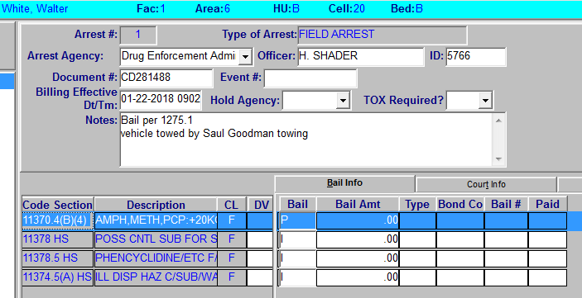
Bail Per 1275.1

Slide 5
Exercises
Covarrubias
Demara
Diaz
Leeon
Matheson
Salmon
Templeton
Thomas

Slide 6
Bail Previously Posted
The court may allow a bail previously posted to remain in effect
Example: Remanded with bail of $50,000, and court document states "Previously posted bail of $40,000 remains in effect"
  The incarcerated individual will need to post the difference of $10,000 to bail out

Slide 7
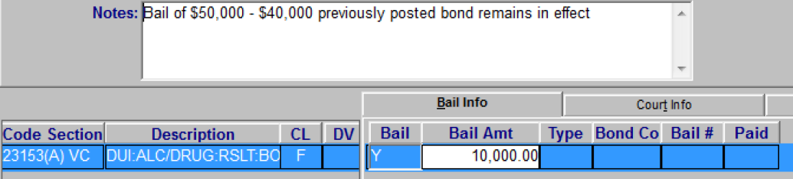
Bail Previously Posted

Slide 8
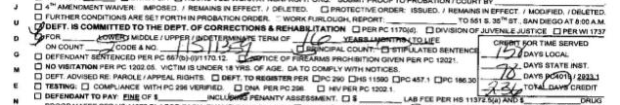
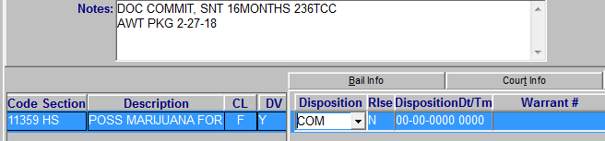

DOC Commits

Slide 9

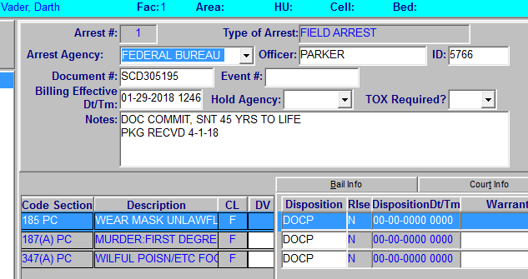
Prison Packages
Verify the Prison Package is complete
  ARJIS and update in JIMS

Slide 10

Prison Packages
Dispositions
If Dispo is COM change to DOCP
If Dispo is LPAP change to LPPR
If housed at another facility only update notes
  "PKG RCVD from (updating facility) enroute to (incarcerated individual’s facility) todays date"

Slide 11
Exercises
Norton
Ortiz
Whitaker
Lackey

