Slide 1
Day IV

Slide 2
Purge
Take everything out of the jacket
Organize according to arrest and date
Compare all documents with what is in JIMS
Check all Document #’s, Court dates, Bail
Run Wants and Warrants
Check SNT Calc (hit calculate)

Slide 3
Quality Assurance
If you are unsure about something what do you do?

Slide 4
Weekenders
At intake
At Release
Temp/Release

Slide 5
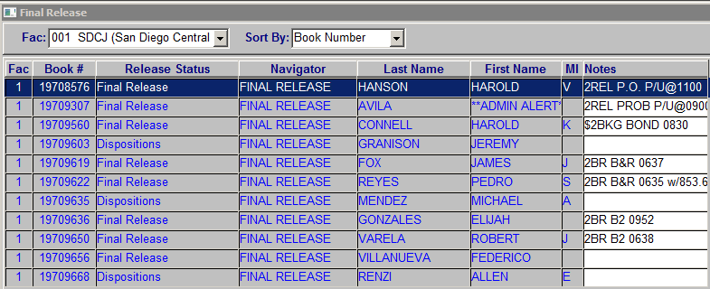
Release Queue
Monitor your release queue

Slide 6
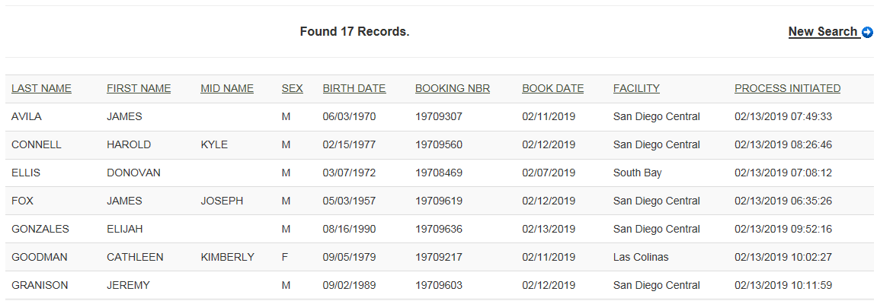
Release Queue
The public has access to the release queue

Slide 7
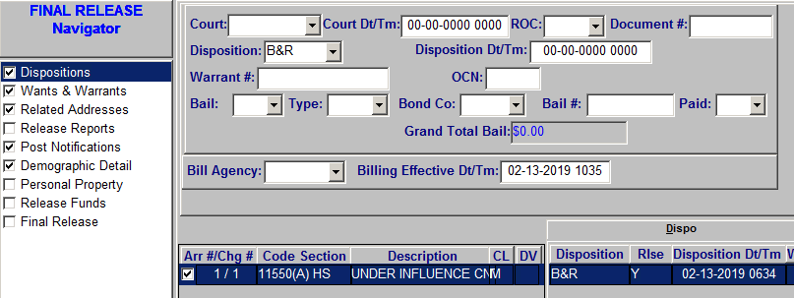
Release
Remember to “re-dispo” the release right before you release

Slide 8
Exercises Part I
Aldaz
Cabrera
Dembitsky
Howe
Shine

Slide 9
Exercises Part II
Dubon
Miller
Moreno
Velasco
Washington

