Slide 1
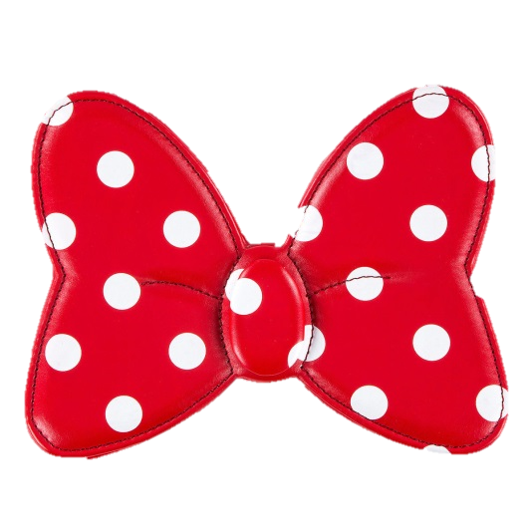
Advanced Phase
Day Two

Slide 2
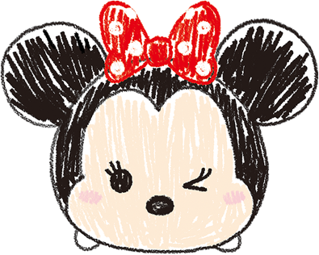
Group 2
Kidd (aka Washington) #19
Lopez #43
Mayorquin #22
Robinson #17
Schilawski #14
Smith #13

Slide 3
Group 3
Bradshaw #26
Moyeda #23
Patty #28

Slide 4
Group 3
Mayorquin #38
Robinson #25
Schilawski #21
Smith#29
Kidd #27

Slide 5
Group 4
Bradshaw #34
Moyeda#31
Patty #42

Slide 6
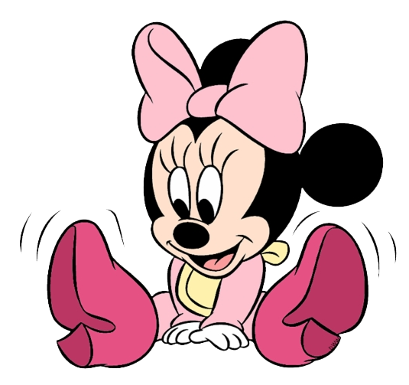
Group 4
Robinson #33
Schilawski #30
Kidd #35

Slide 7
Group 5
Bradshaw#40
Robinson #39
Schilawski#36
Kidd #41

