Slide 1
Advanced Phase
Day One

Slide 2
Ground Rules
Please arrive on time
Call or text if you are running late
No cell phone
No internet/e-mail
Plenty of breaks
One hour lunch
If you have a question, please raise your hand
Do not ask your coworkers

Slide 3
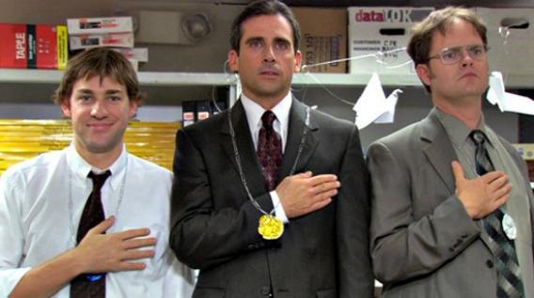
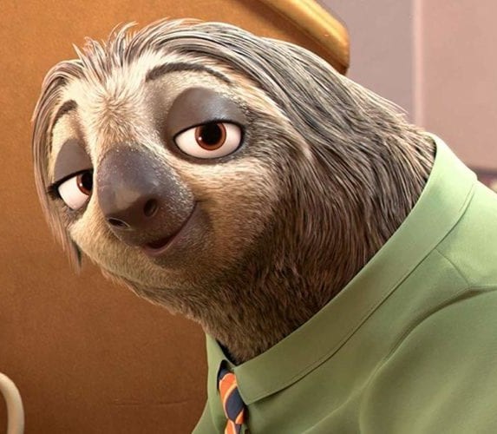
Video 1 Video 2 Video 3

Slide 4
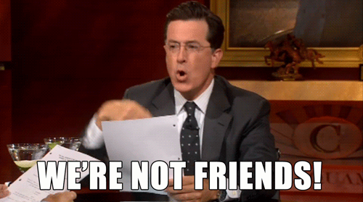
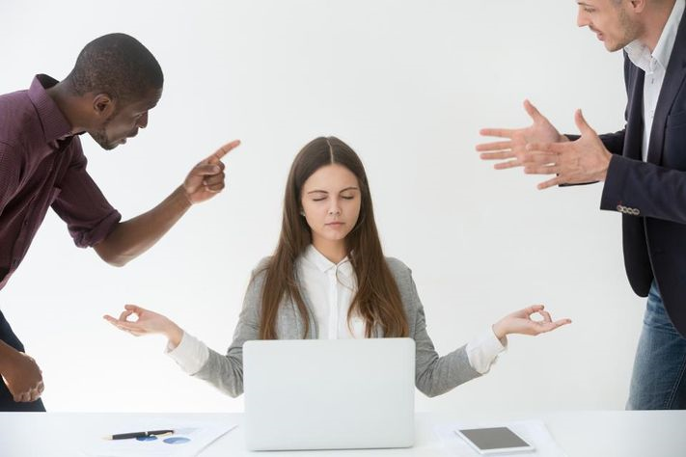
Co-Worker Video
Remain Professional

Slide 5
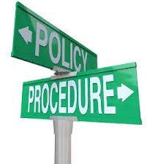
Policy and Procedure M.5 – Taking appropriate action
If you witness a medical emergency…
Notify sworn/medical staff immediately”

Slide 6
Pre Book
Lundy
Delgado
Astorga
Johnson
Calac
Hawkins
Love
Lindsay

Slide 7
Group 1
Bradshaw #9
Gooden#3
Moyeda#6
Patty#11
Pegues#4

Slide 8
Group 1
Kidd#10
Lopez#12
Mayorquin#5
Robinson#8
Schilawski#2
Smith#1

Slide 9
Group 2
Bradshaw #18
Gooden # 37
Moyeda #15
Patty #20

